Slide 1
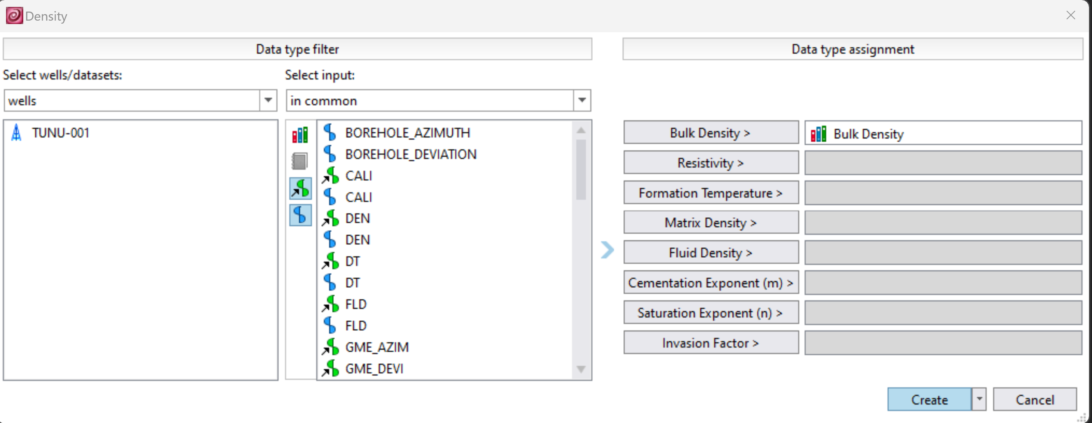
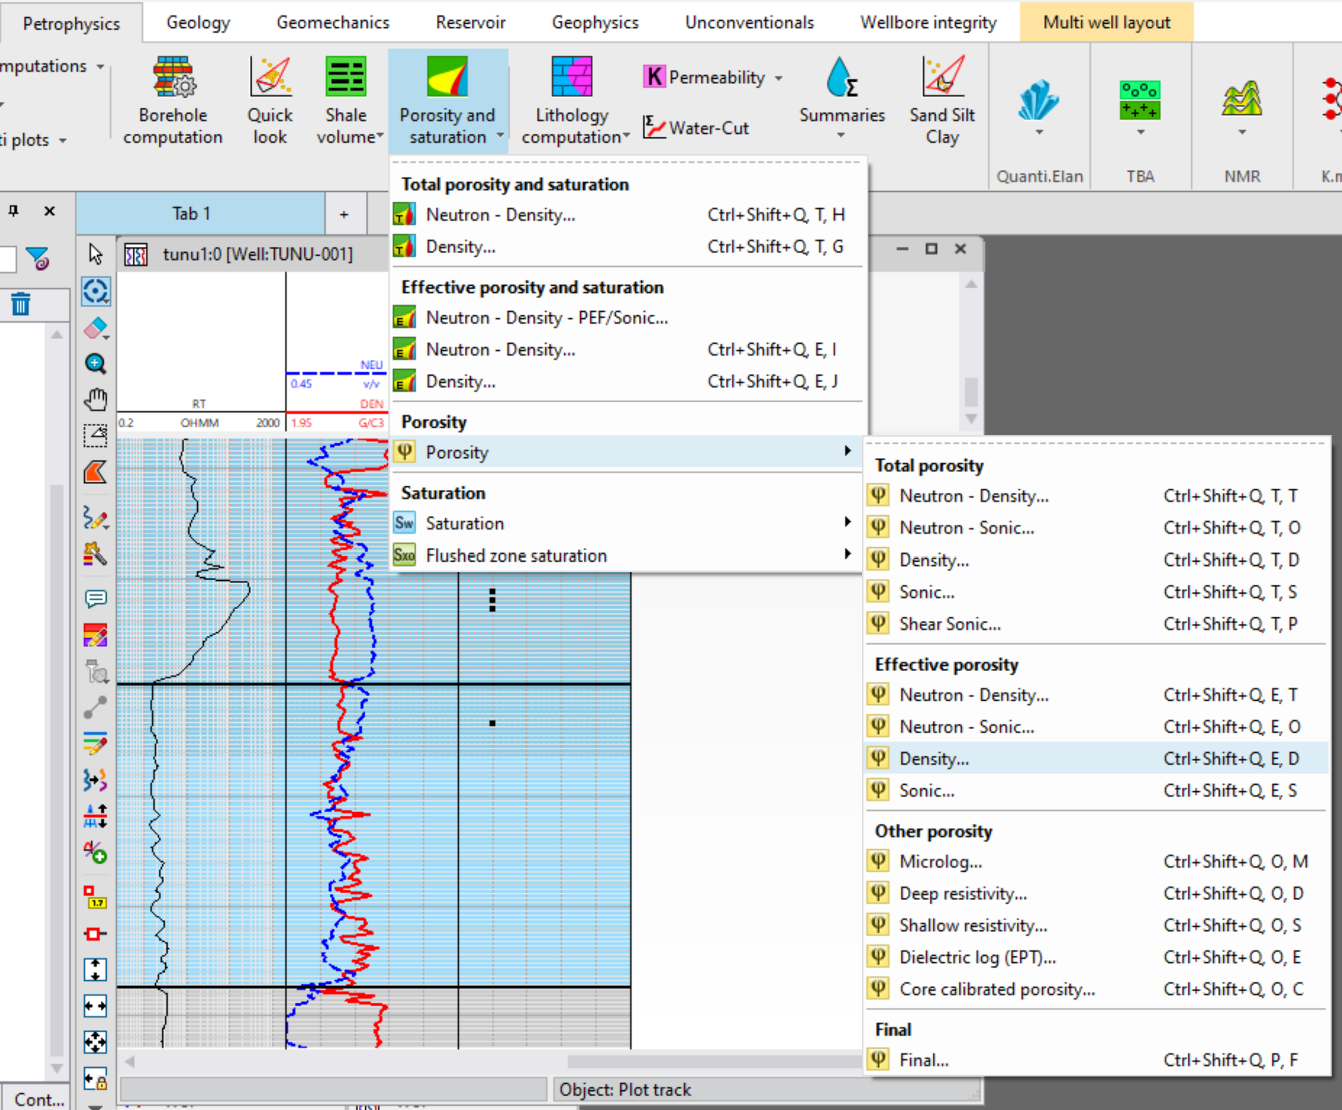
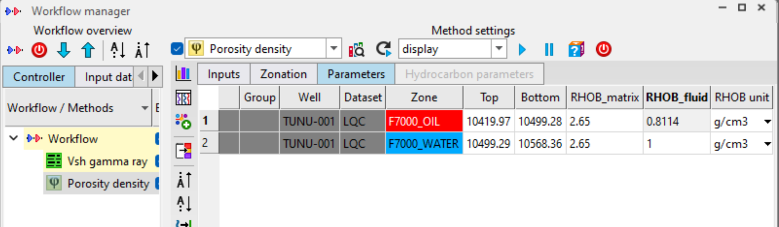
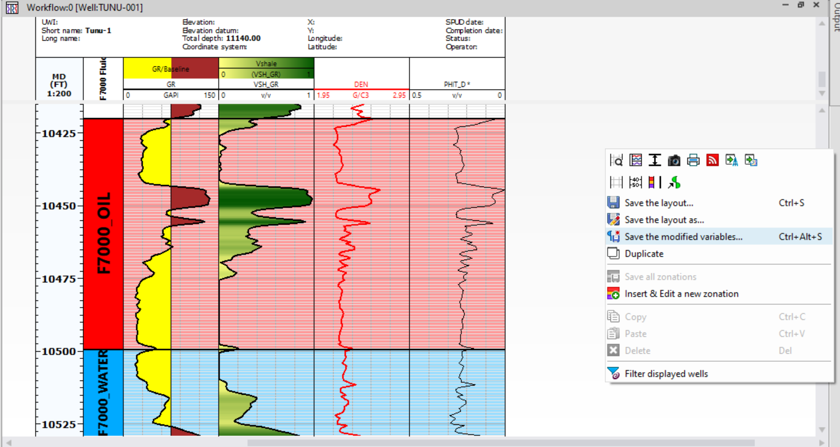
POROSITY [RFT] (2)
INSERT ONLY THE WATER AND OIL ZONES. INPUT THE CALCULATED DENSITY AND LEAVE WATER DENSITY AS 1G/CC. RUN THE EVALUATION
ON THE PETROPHYSICS TAB, NAVIGATE AND SELECT DENSITY POROSITY
INSERT THE BULK DENSITY AND CLICK ON CREATE
RESULT LOG DISPLAYED. SAVE THE MODIFIED VARIABLE (LOG)

Slide 2
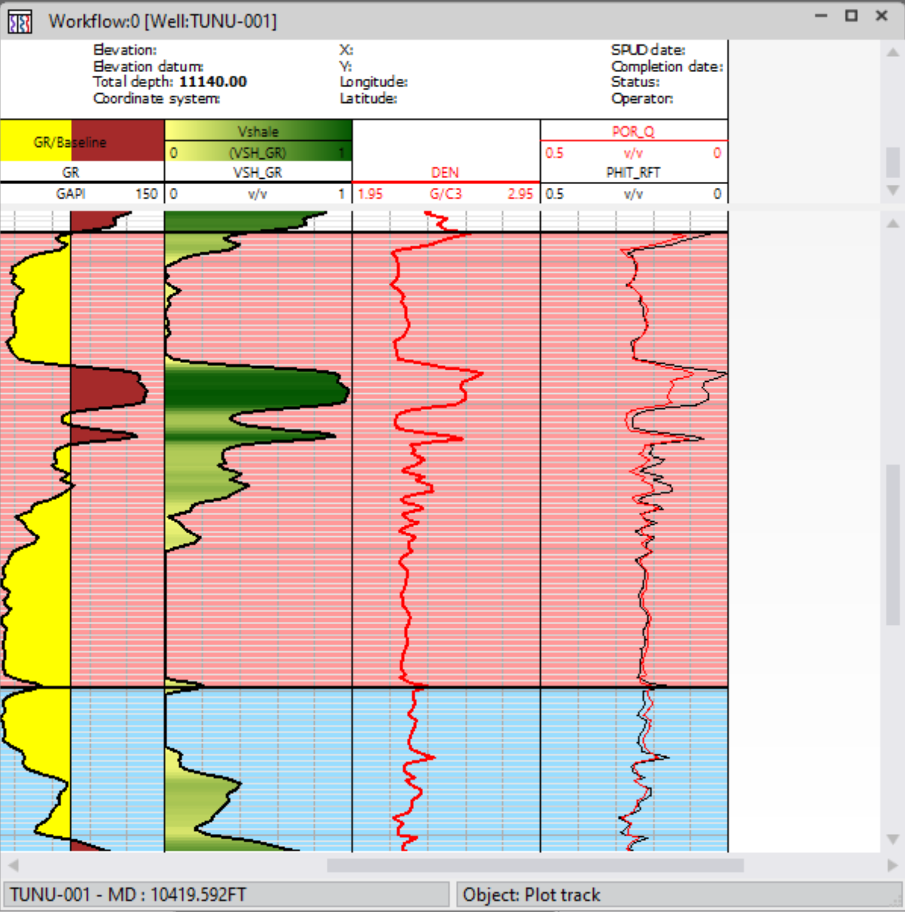
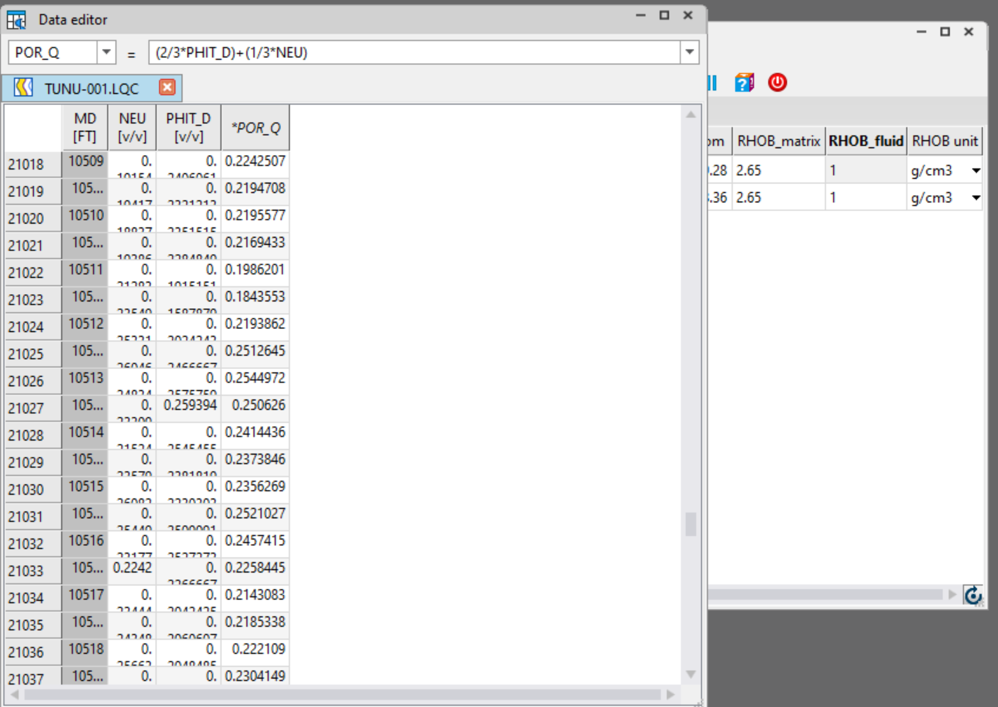
POROSITY [QUICK LOOK]
ALTERNATIVELY, A QUICK LOOK EVALUATION METHOD CAN BE USED TO ESTIMATE POROSITY IN A CASE RFT LOG MAY NOT BE AVAILABLE. EVALUATE POROSITY FROM DENSITY JUST LIKE IN THE PREVOUIS SLIDE INSTEAD USING 1G/CC FOR THE FLUID DENSITY. INPUT THE FOLLOWING EQUATION IN DATA EDITOR AND PRESS ENTER. A POROSITY LOG FROM THE DENSITY POROSITY AND NEUTRON LOG WILL BE CREATED
RESULTS SHOW THAT THE QUICK LOOK POROSITY AND THE RFT POROSITY TRACK EACH OTHER EXCEPT FOR THE SHALE INTERVALS.

Slide 3
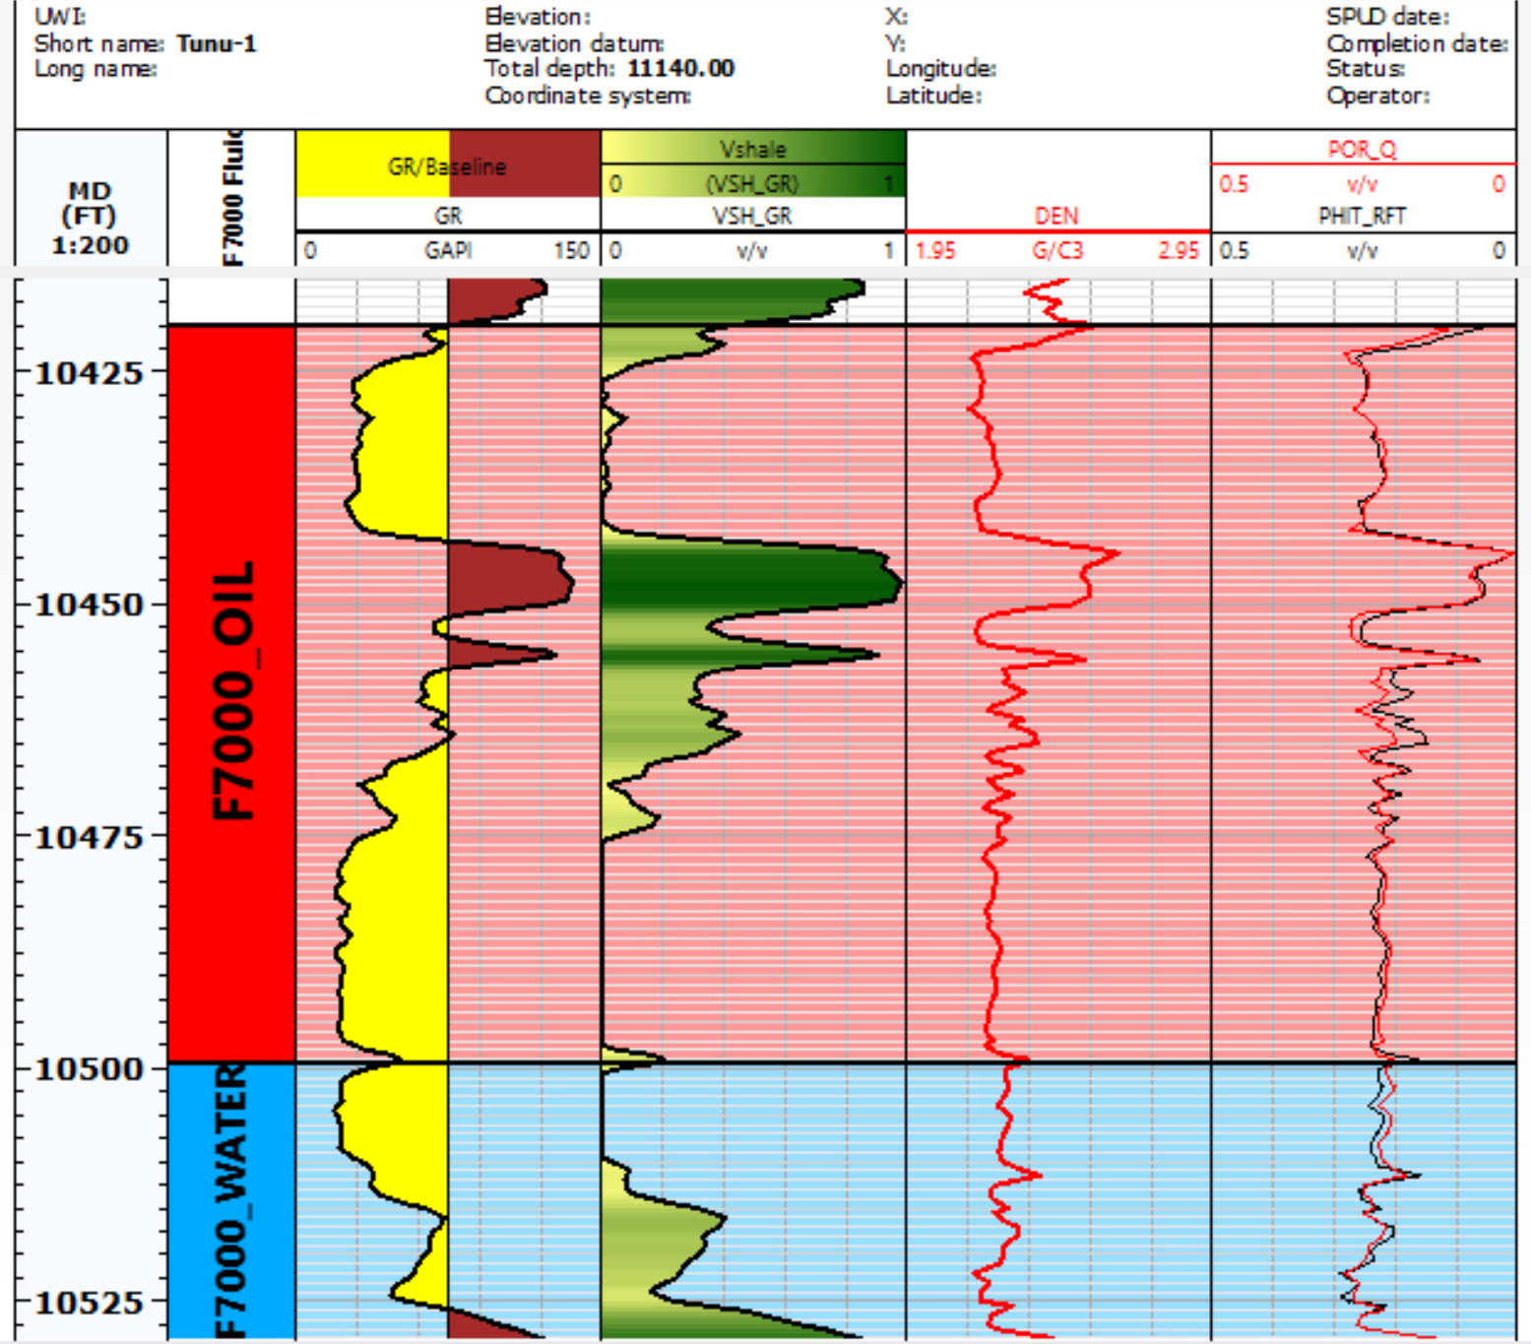
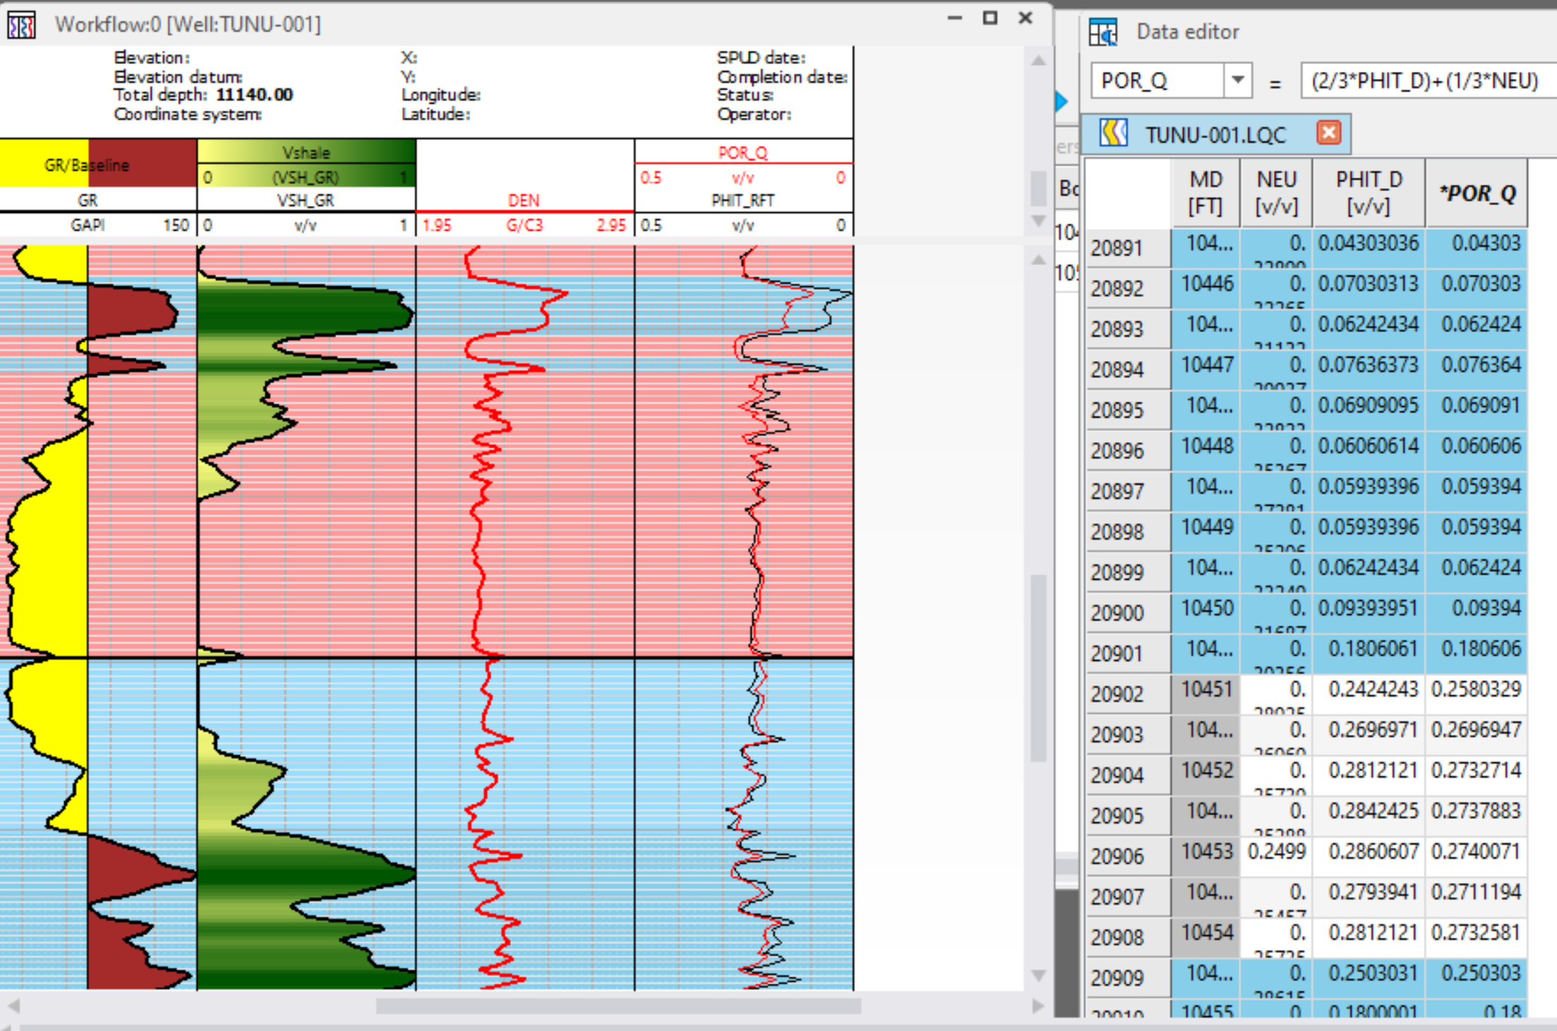
POROSITY [QUICK LOOK] (2)
THE SHALE INTERVALS ARE NOT SUPPOSED TO BE CORRECTED FOR SO WE GO BACK TO OUR DATA EDITOR AND INPUT THE SAME VALUES FOR THE DENSITY POROSITY IN OUR NEWLY CREATED POR_Q LOG IN THE SHALE INTERVALS.
OUR QUICK LOOK EVALUATED POROSITY MATCHES WITH OUR POROSITY EVALUATED FROM RFT DATA SO EITHER LOG CAN BE USED

Slide 4
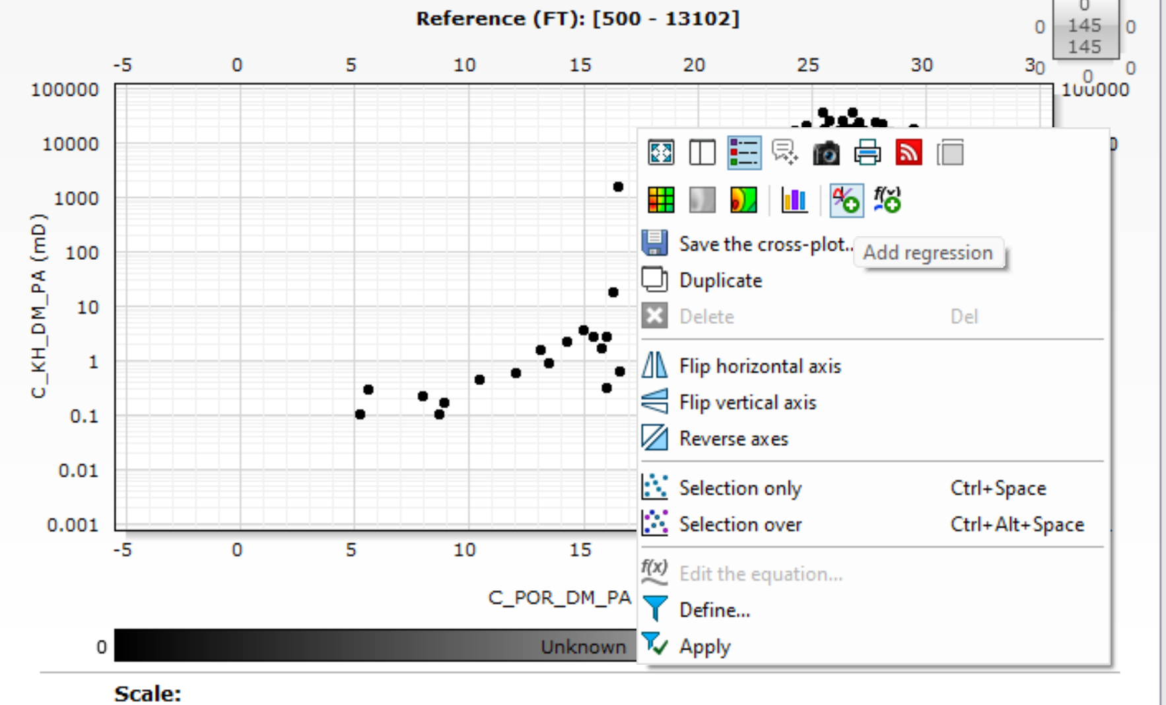
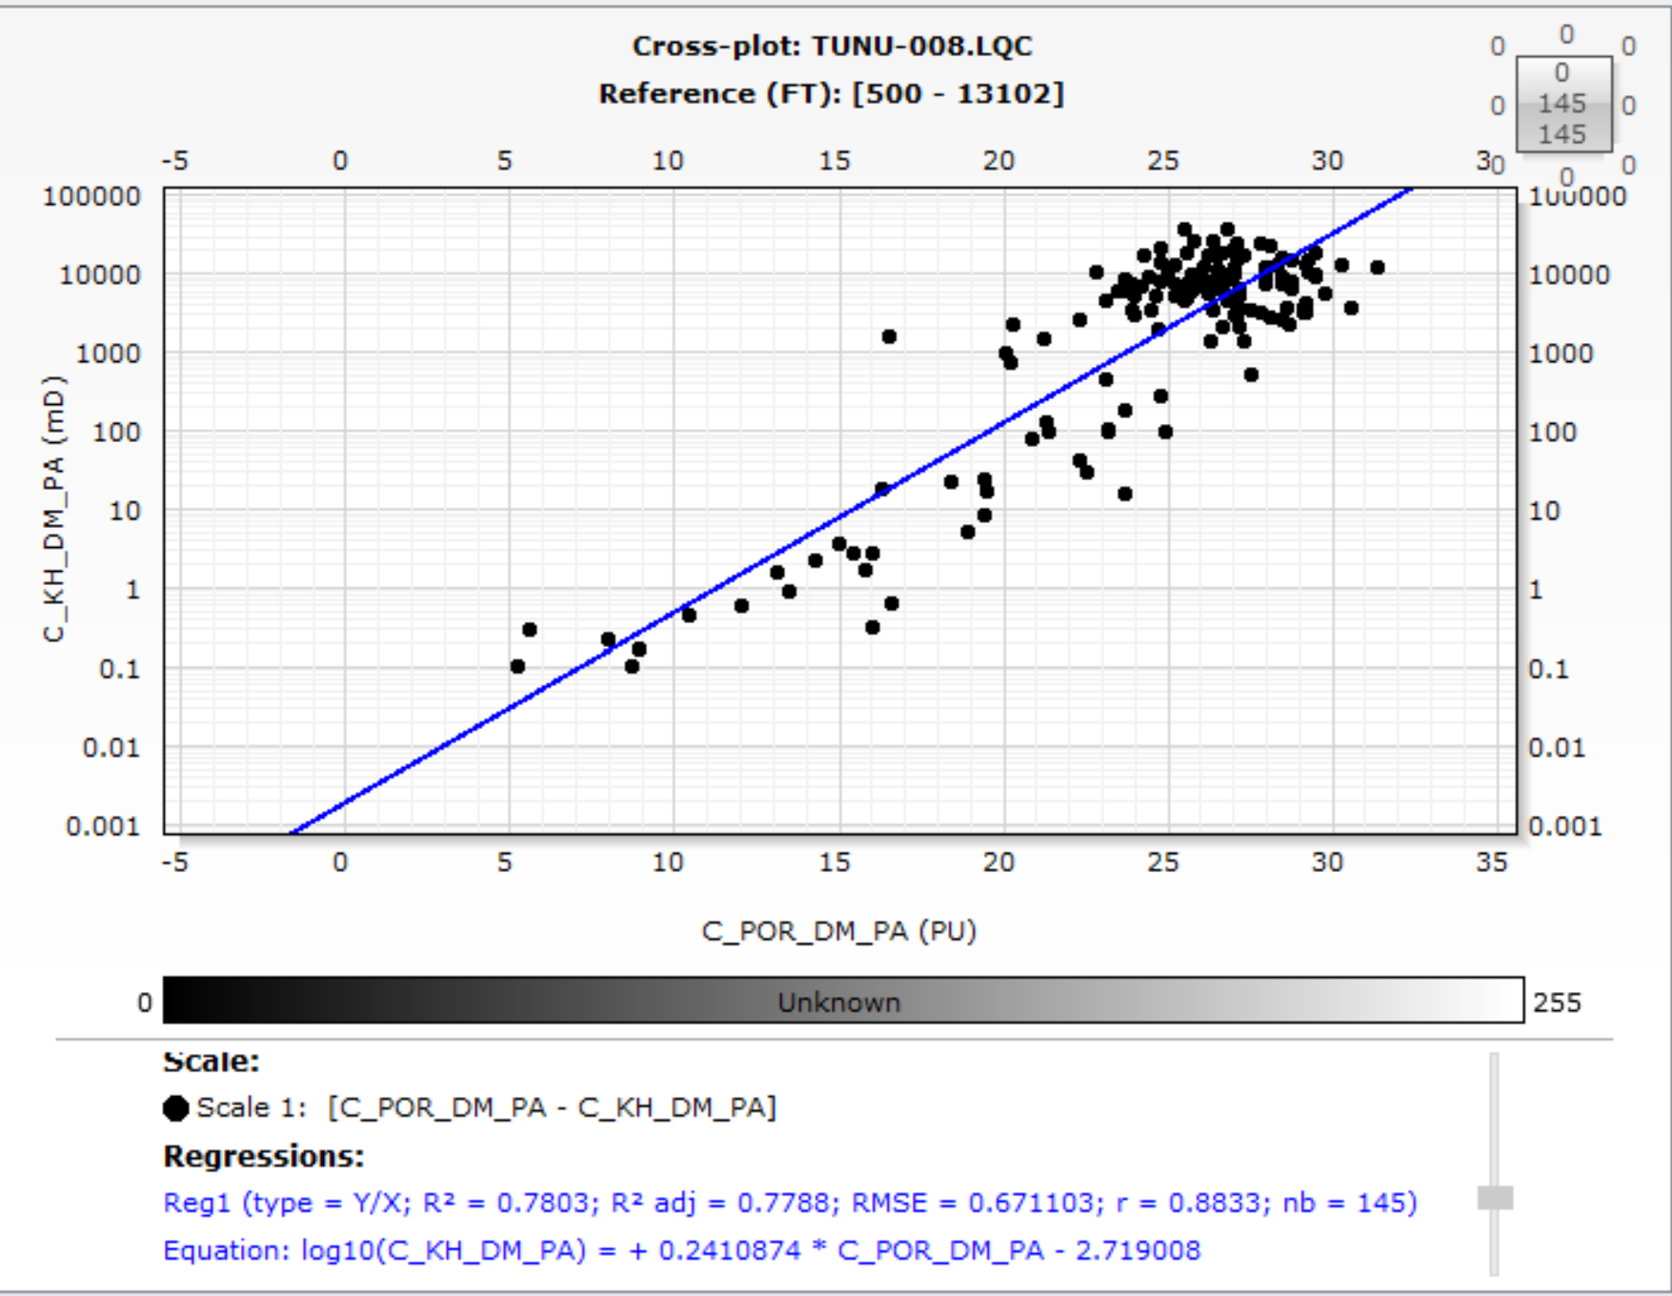
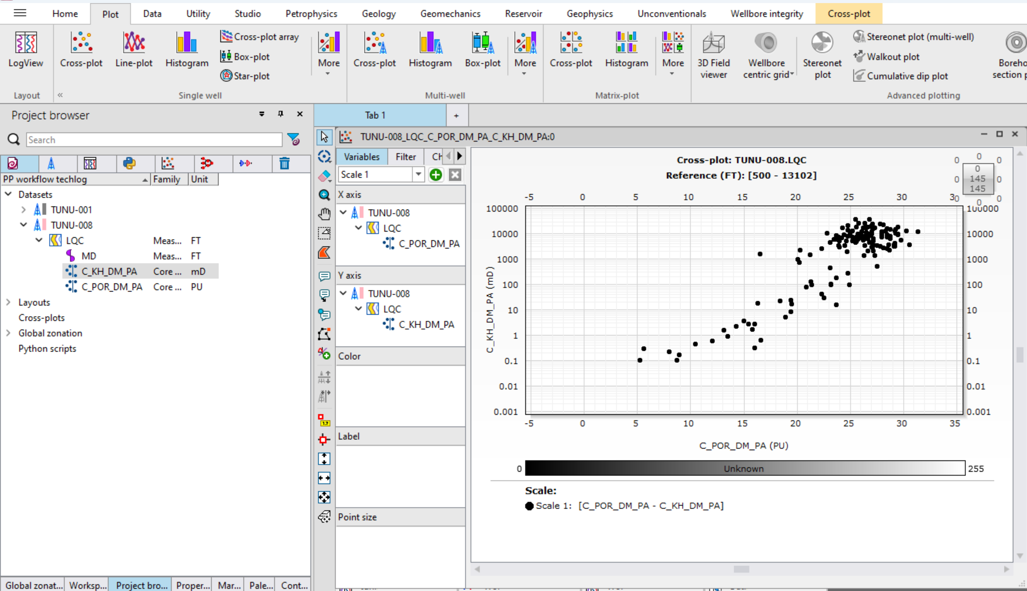
PERMEABILITY
RIGHT CLICK ON THE CROSS PLOT AND SELECT THIS ICON TO ADD A REGRESSION LINE
ON THE PLOT TAB, CLICK ON CROSS PLOT. DRAG AND DROP PERMEABILITY AND POROSITY CORE LOGS
EQUATION DEFINING THE RELATIONSHIP BETWEEN POROSITY AND PERMEABILITY FROM CORE ANALYSIS

Slide 5
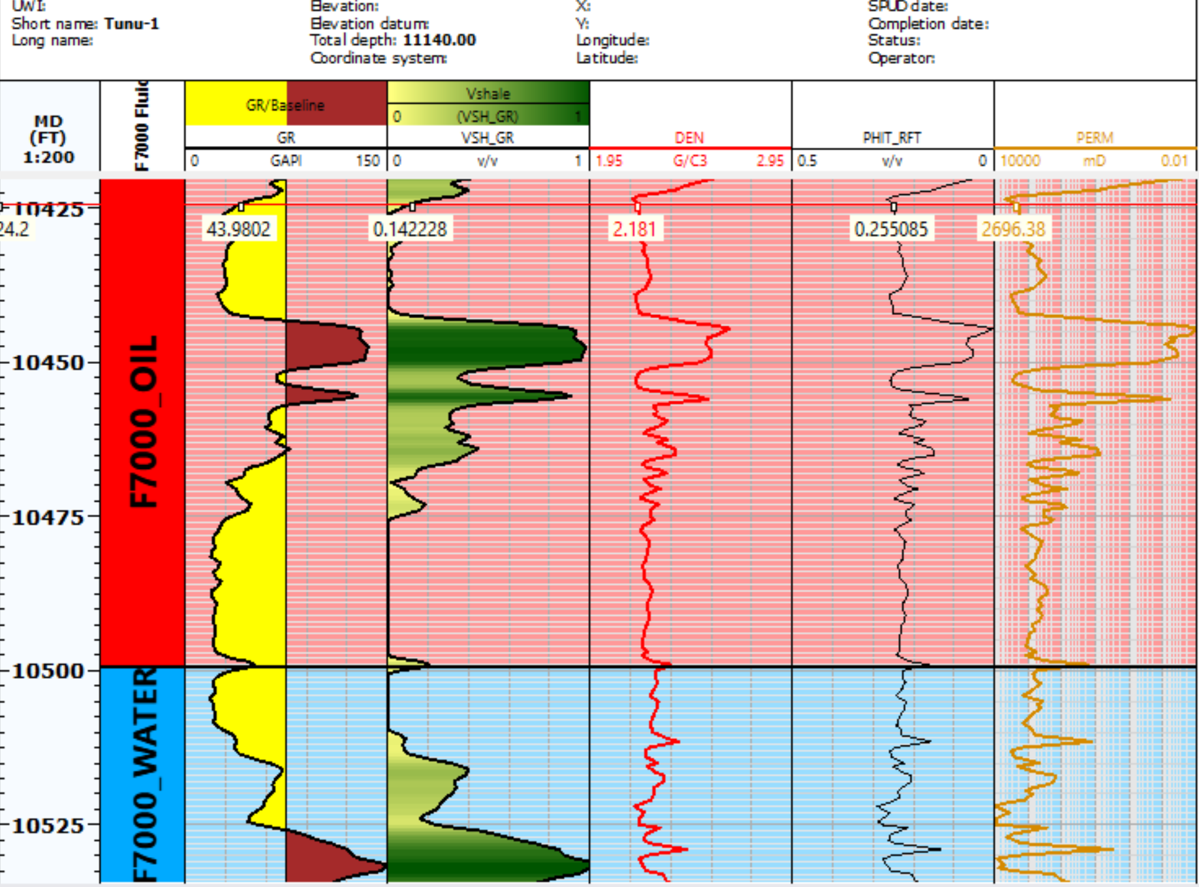
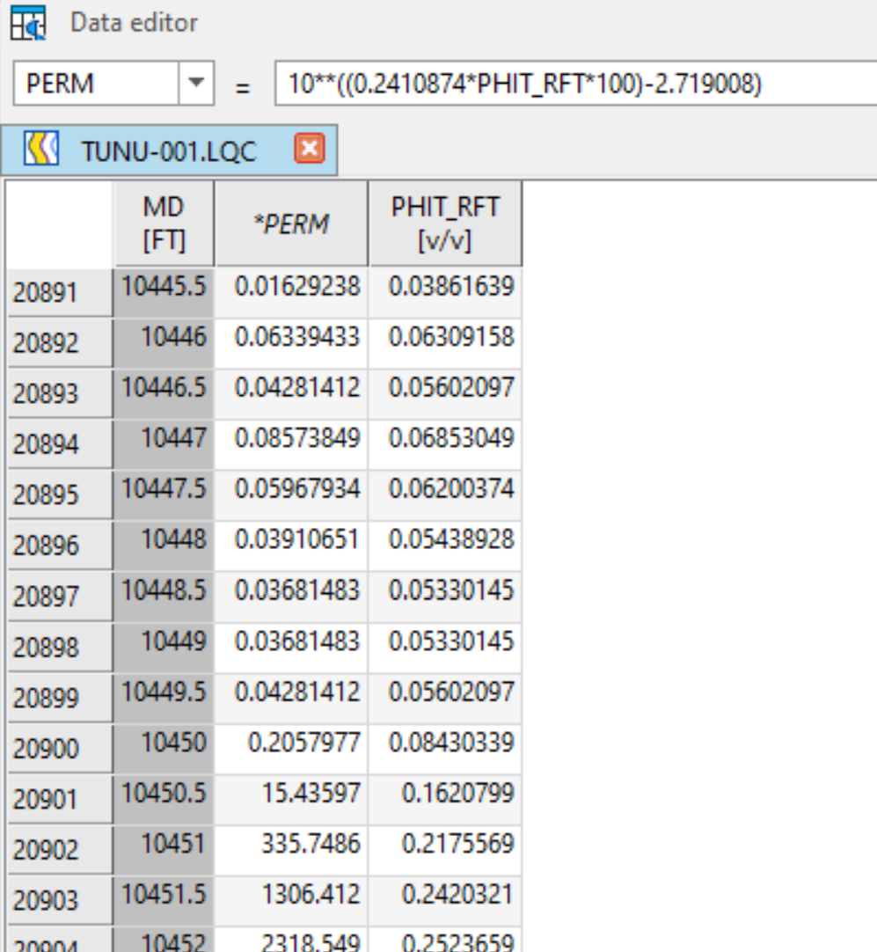
PERMEABILITY (2)
SAVE MODIFIED VARIABLE AND DISPLAY PERMEABILITY LOG ON WELL LAYOUT
INPUT THE PERMEABILITY EQUATION FROM THE CROSS PLOT ON DATA EDITOR AND PRESS ENTER TO CREATRE A PERMEABILITY LOG

Slide 6
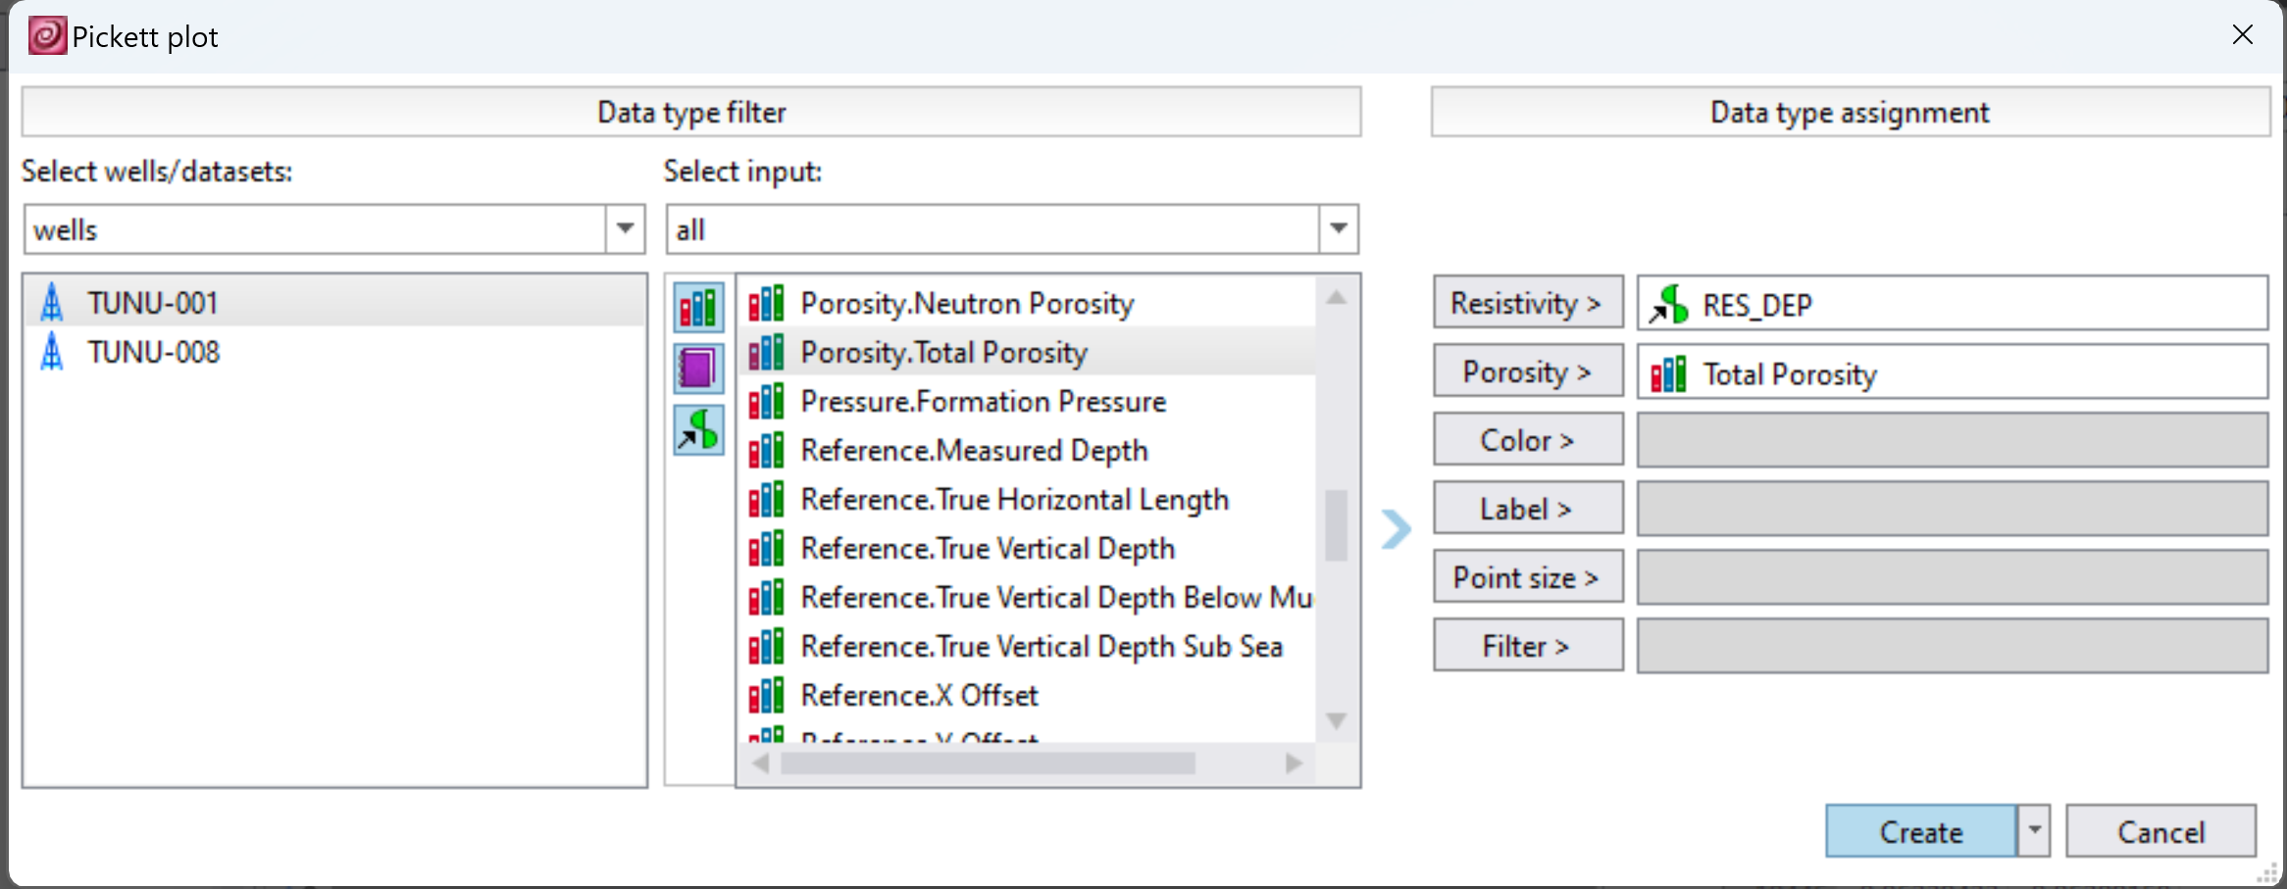
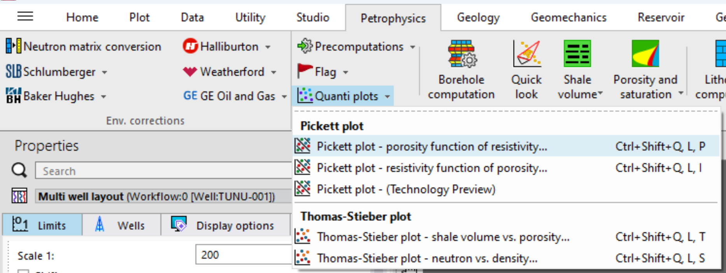
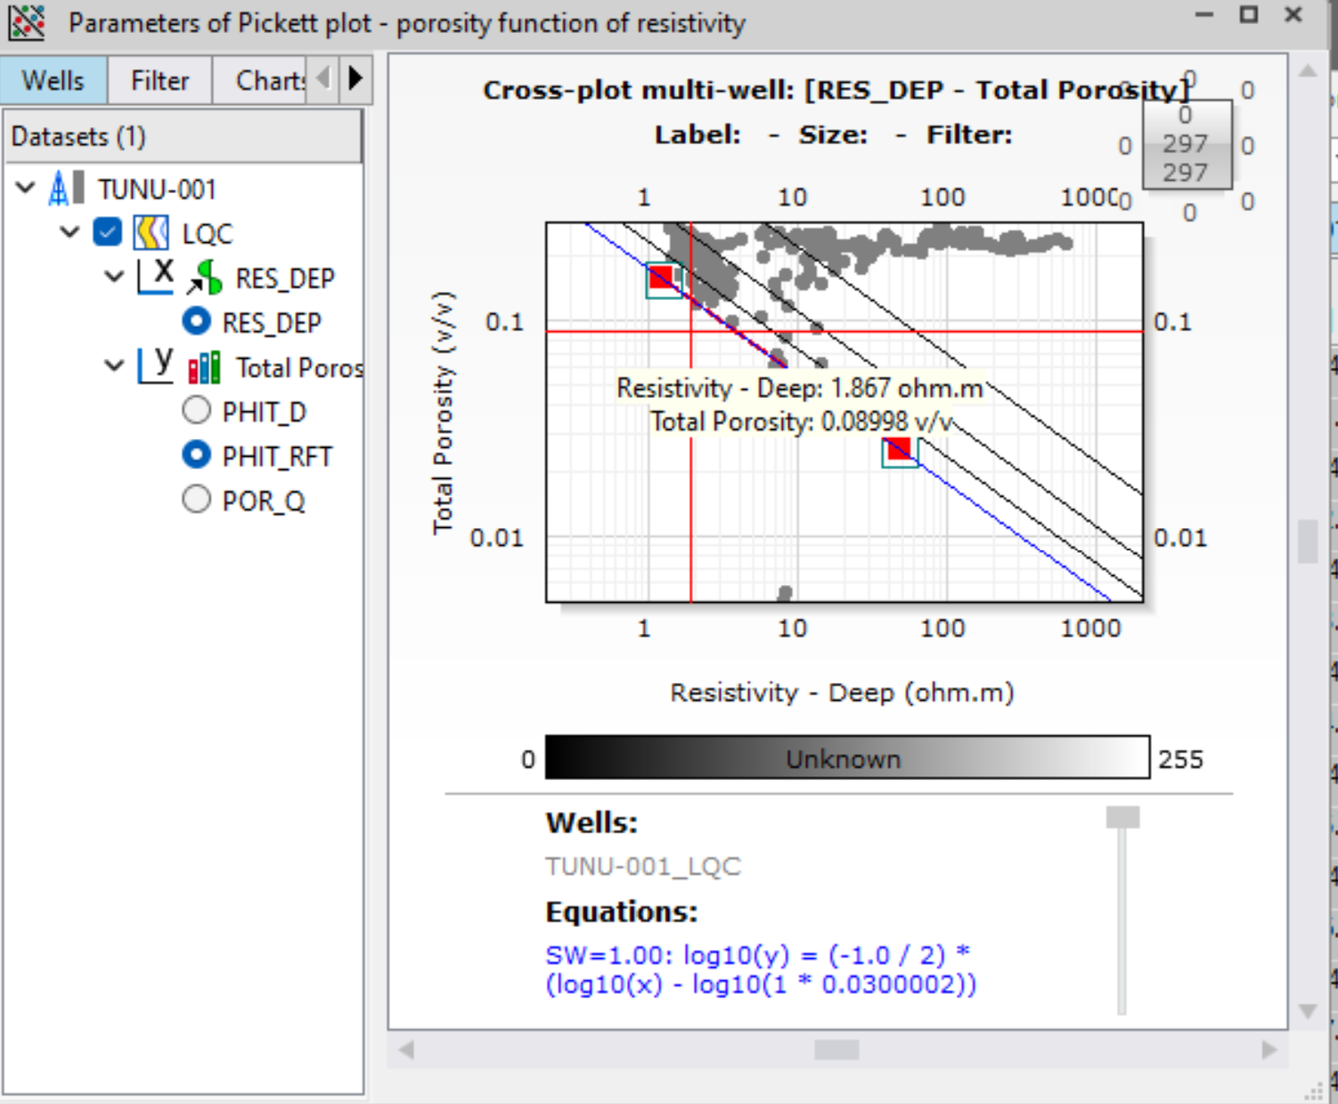
SATURATION
ON THE PETROPHYSICS TAB, CLICK ON QUANTI PLOTS AND SELECT PICKETT PLOT (RESISTIVITY)
SELECT THE INPUTS AND CLICK ON CREATE
RIGHT CLICK ON THE PICKETT PLOT AND CLICK ON SELECTION ONLY. THIS WILL SHOW ONLY HIGHLIGHTED POINTS ON THE PLOT. MAKE SURE TO RIGHLIGHT THE CLEAN SAND INTERVALS IN THE WATER LEG
SELECT PARTICULAR LOG TO BE USED FOR THE EVALUATION

Slide 7
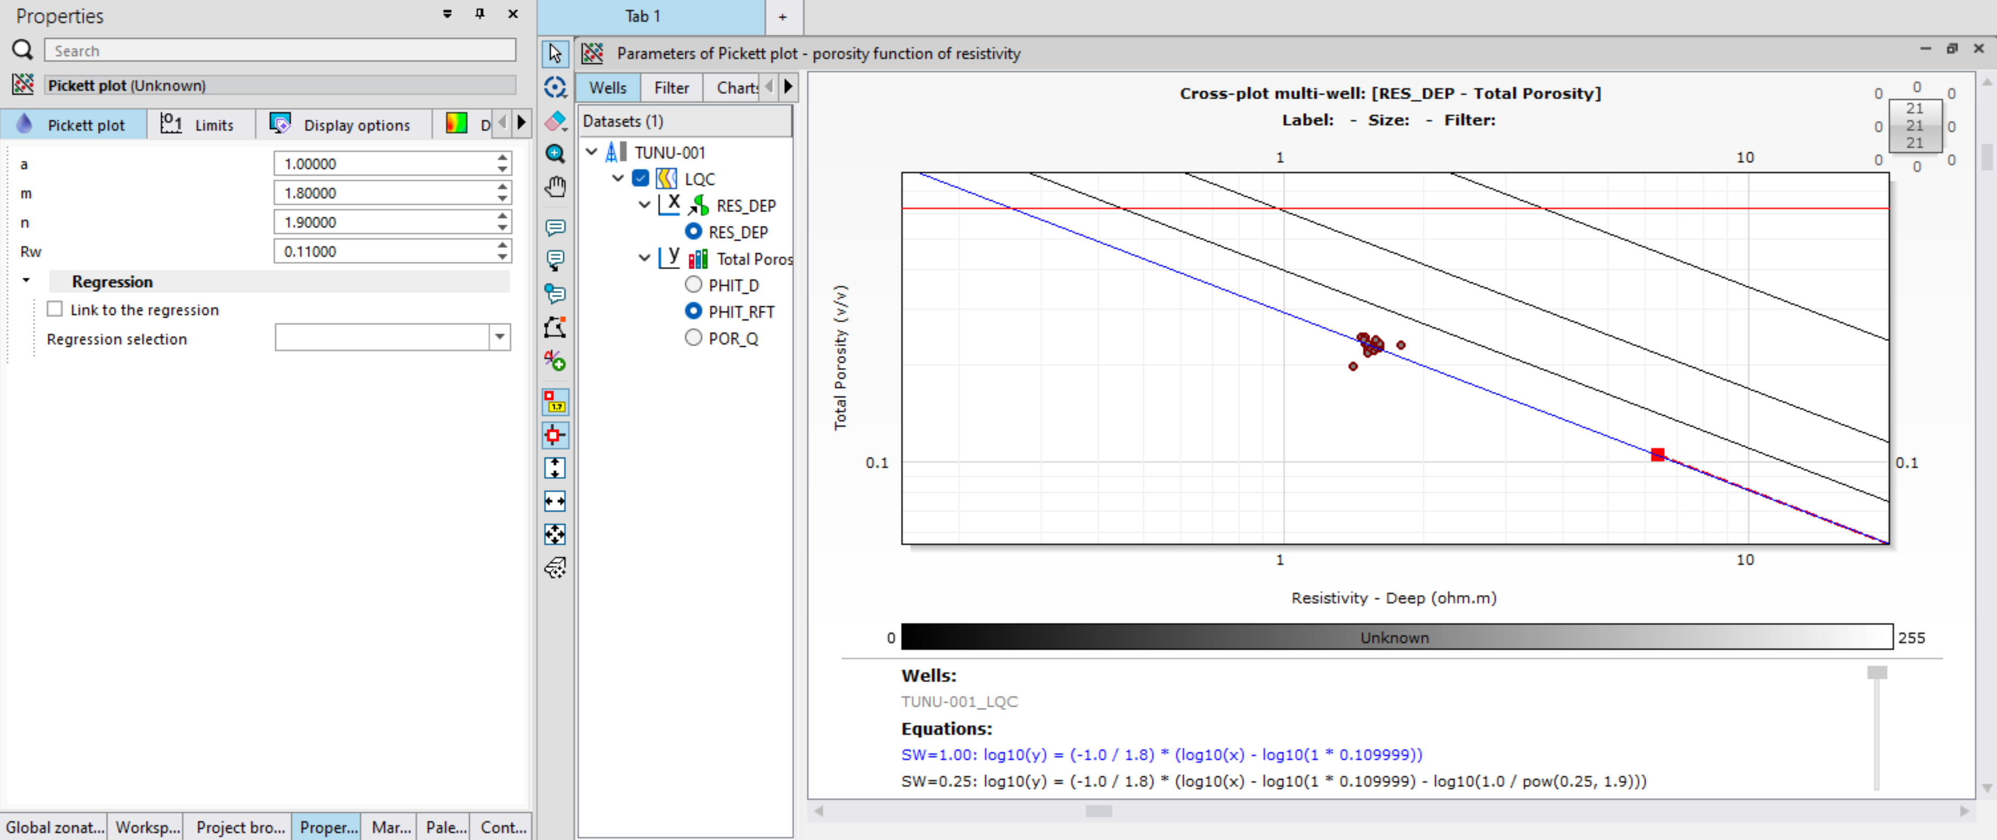
SATURATION (2)
ADJUST Rw VALUE UNTIL THE 100% SATURATION LINE (THE BLUE LINE) IS IN LINE WITH THE SELECTED POINTS ON THE PICKETT PLOT
SET m AND n VALUES AT 1.8 AND 1.9 RESPECTIVELY (NIGER DELTA VALUES)

Slide 8
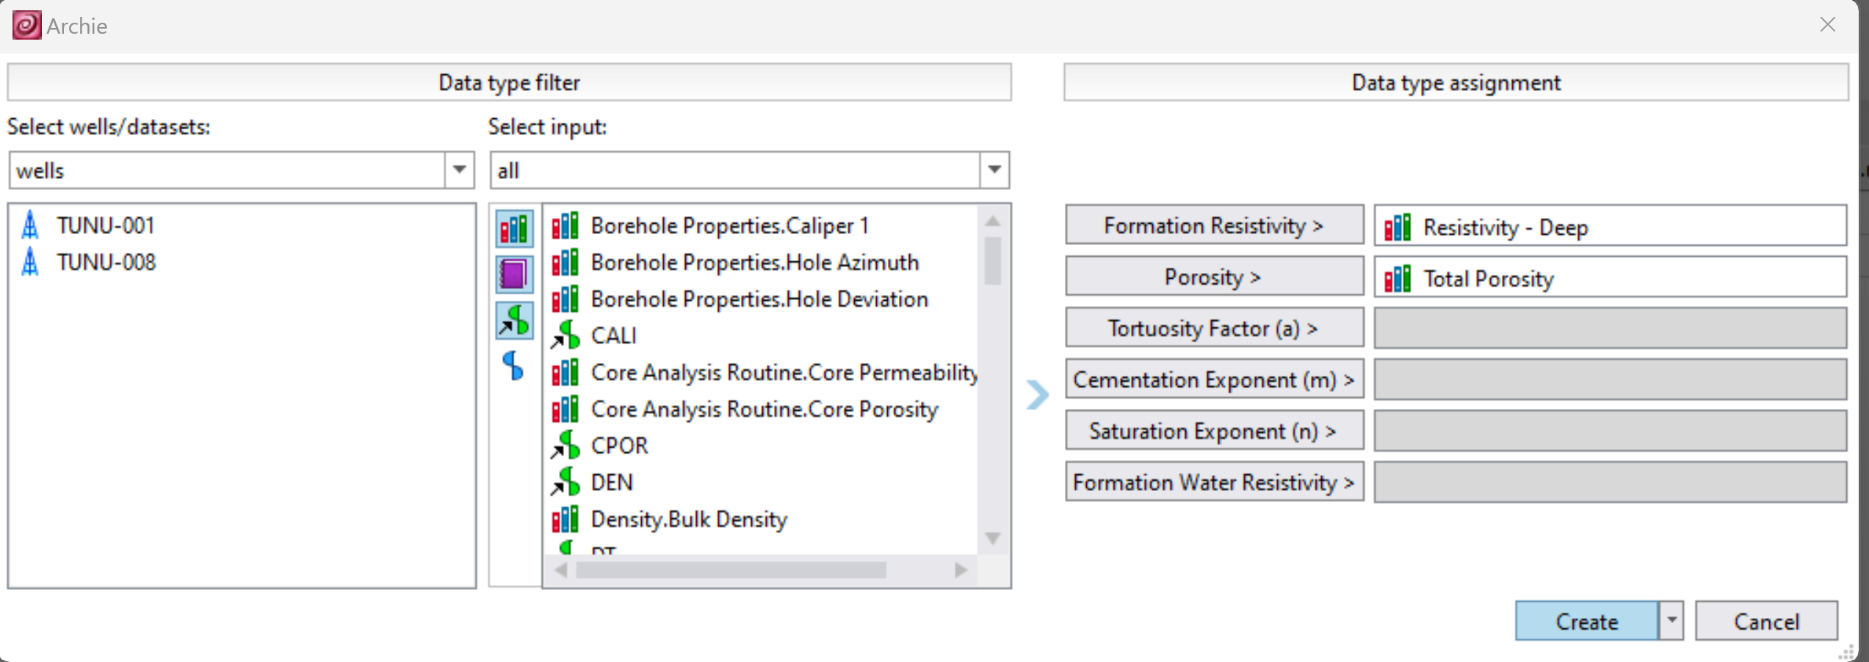
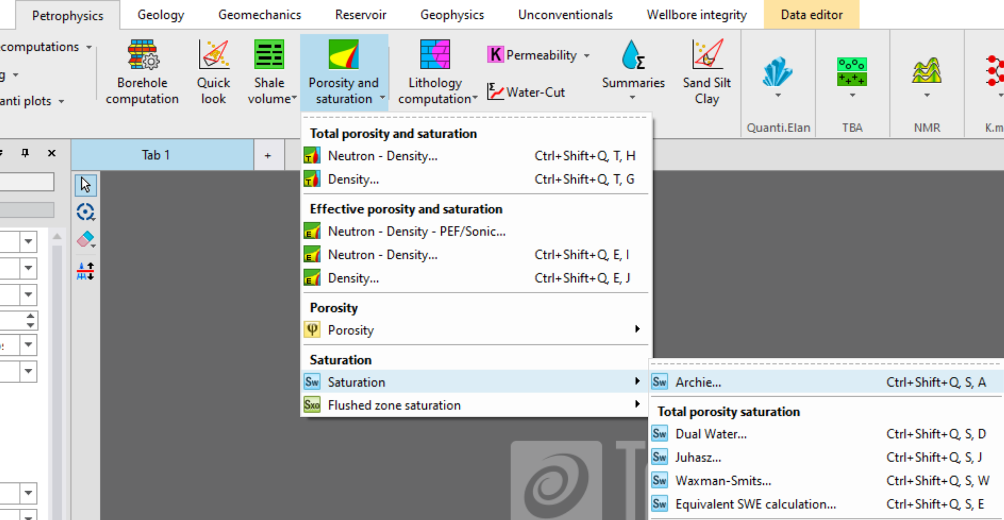
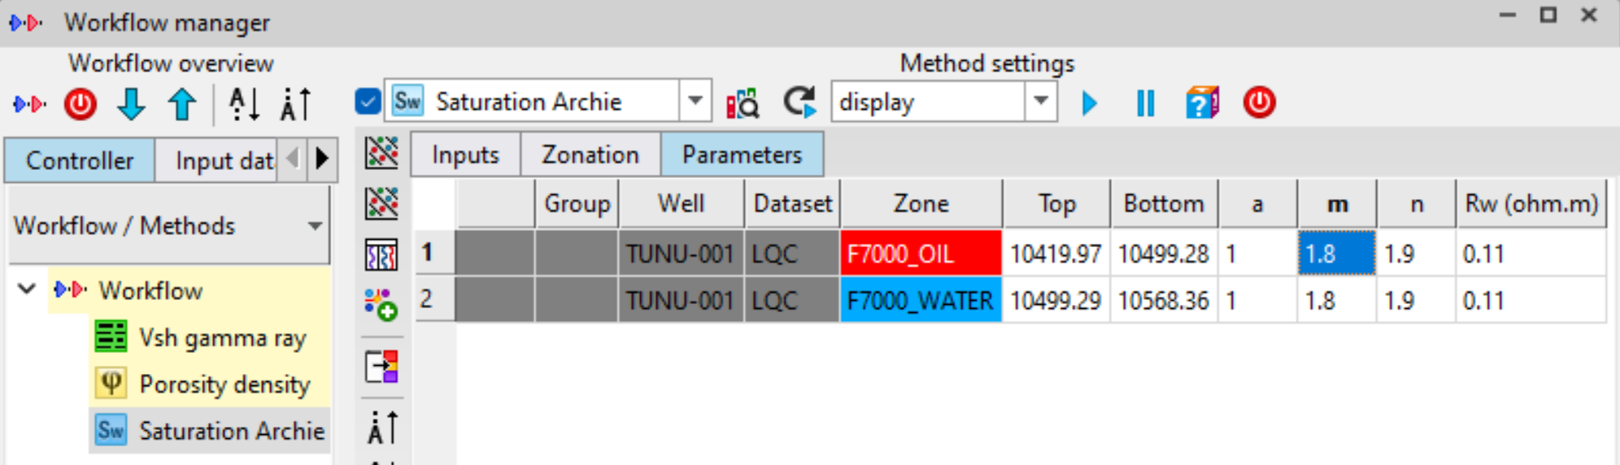
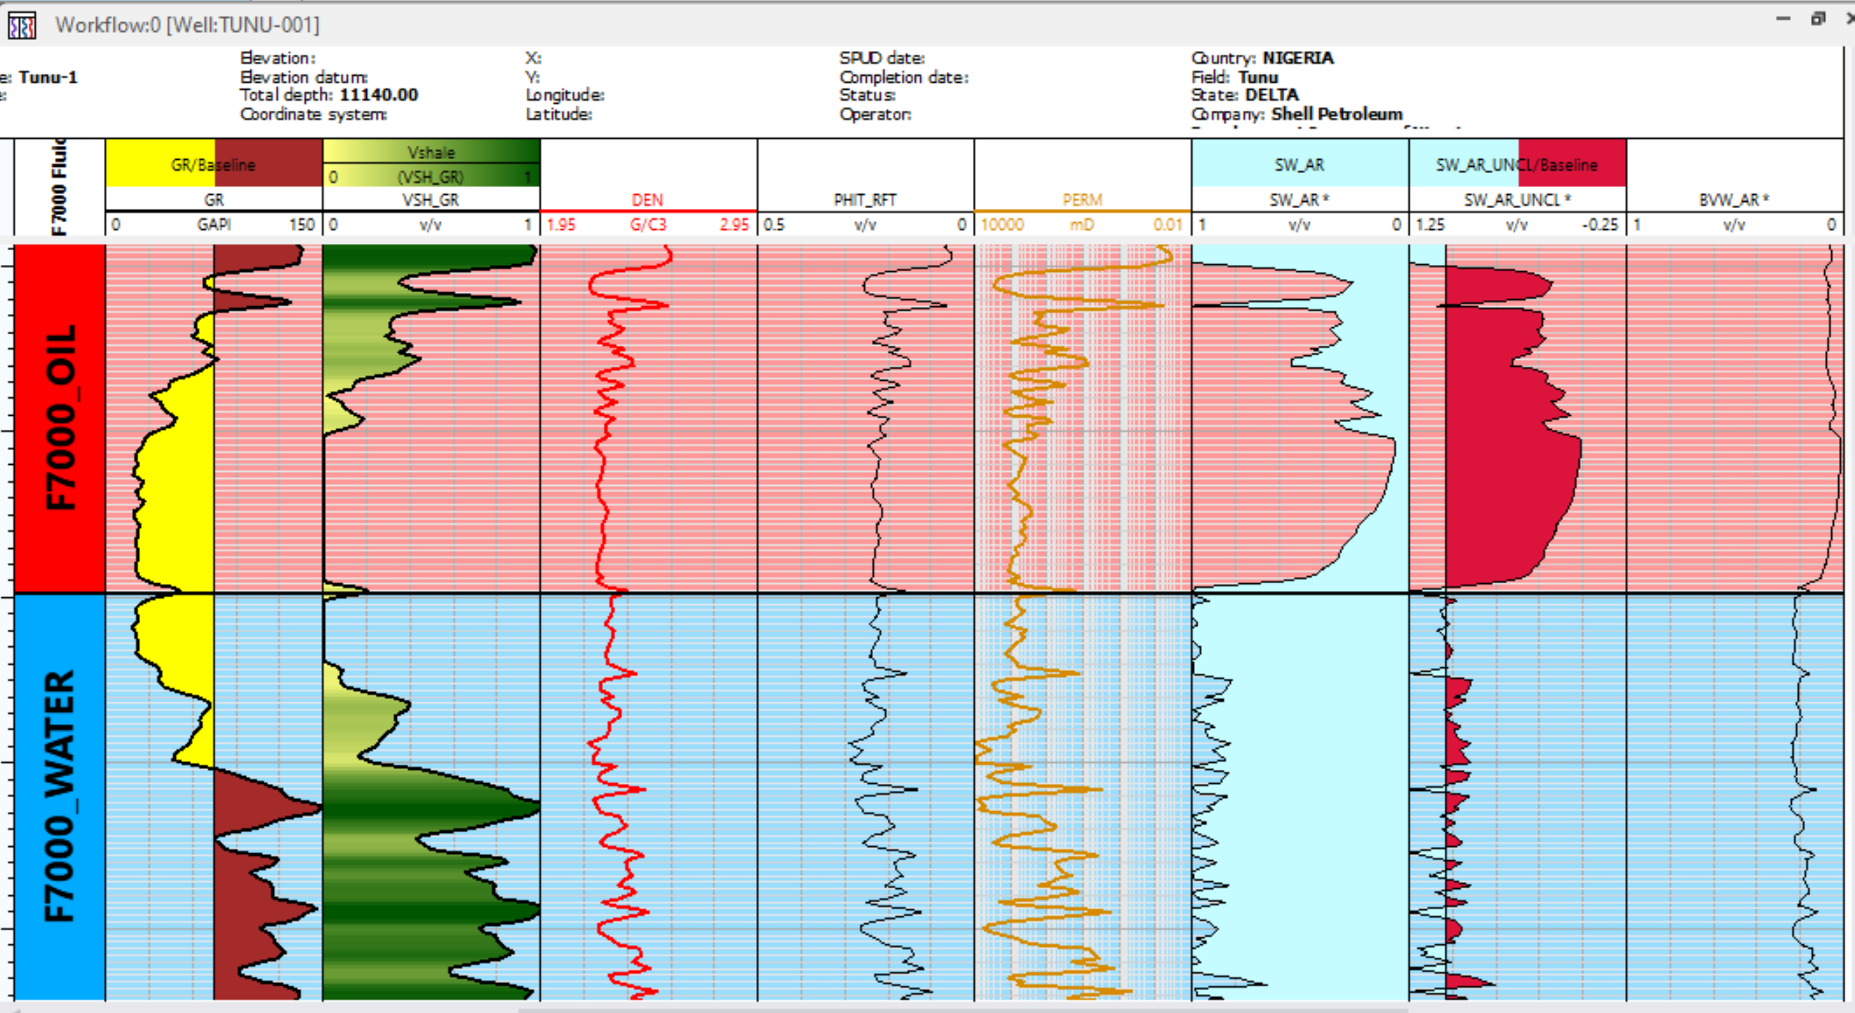
SATURATION (3)
ON THE PETROPHYSICS TAB, NAVIGATE AND SELECT ARCHIE SATURATION
SELECT THE INPUTS AND CLICK ON CREATE
FILL IN m AND n PARAMETERS AND INPUT Rw VALUE GOTTEN FROM PICKET PLOT AND RUN EVALUATION
RESULTANT Sw LOG. SAVE ALL MODIFIED VARIABLES
THE UNLIPPED SATURATION LOG SHOULD TRACK OR BE AS CLOSE AS POSSIBLE TO THE 100% BASELINE IN THE CLEAN SAND INTERVAL. USE THIS TO QC YOUR EVALUATED SATURATION

Slide 9
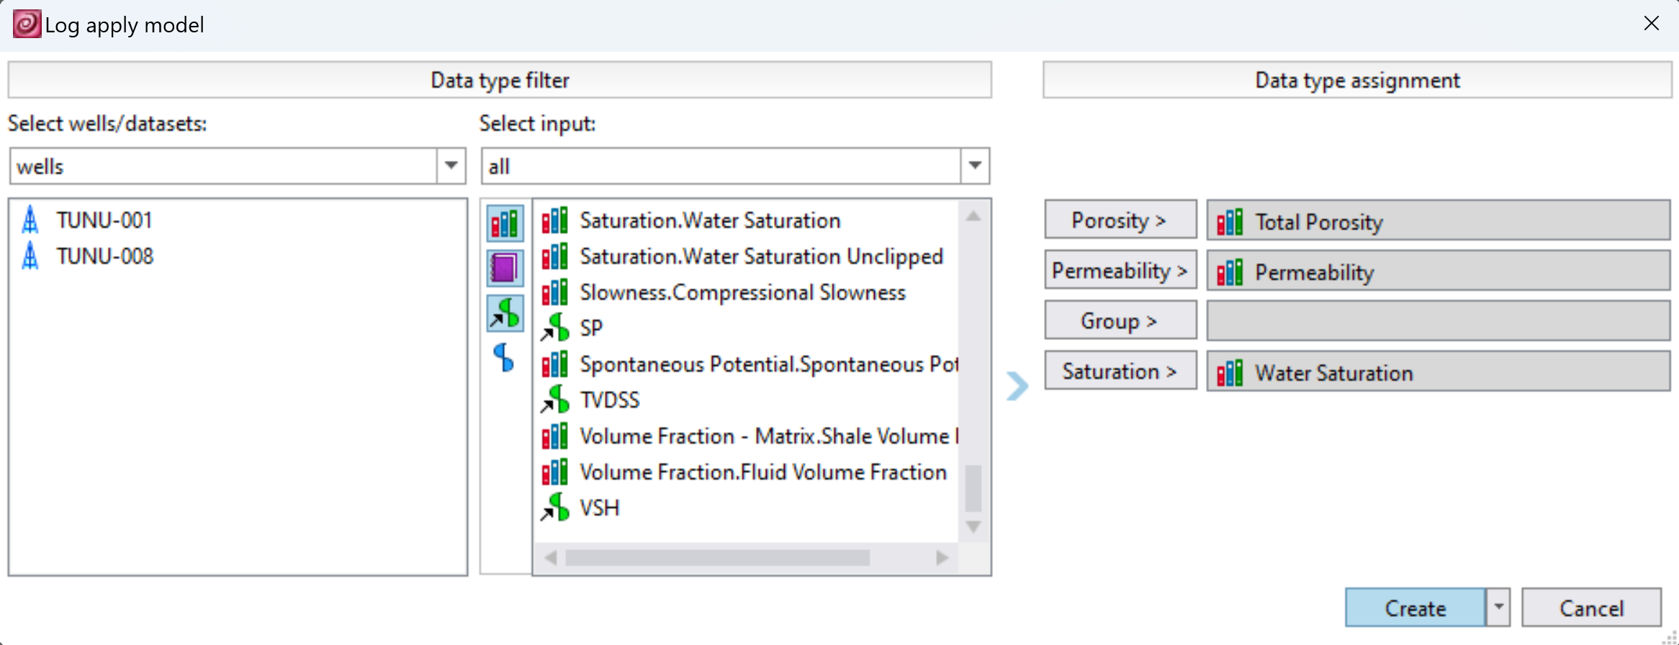
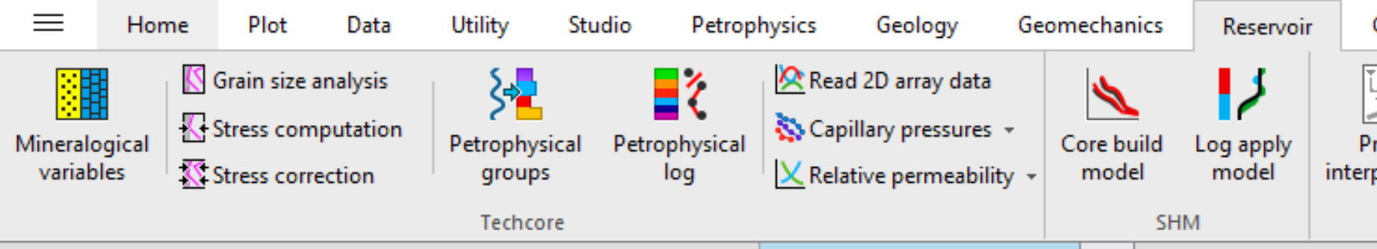
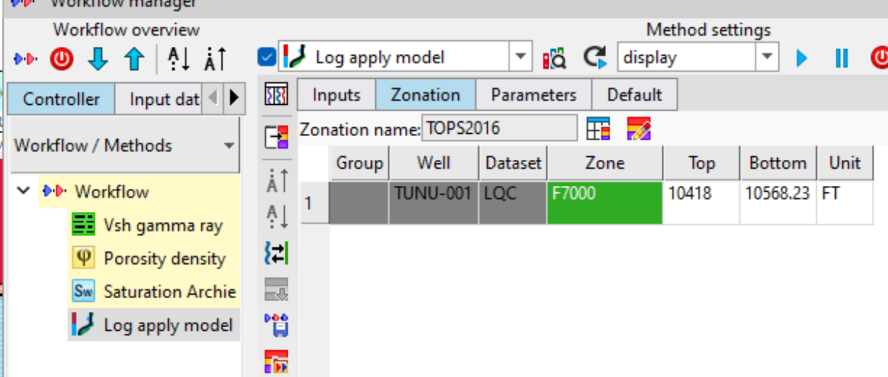
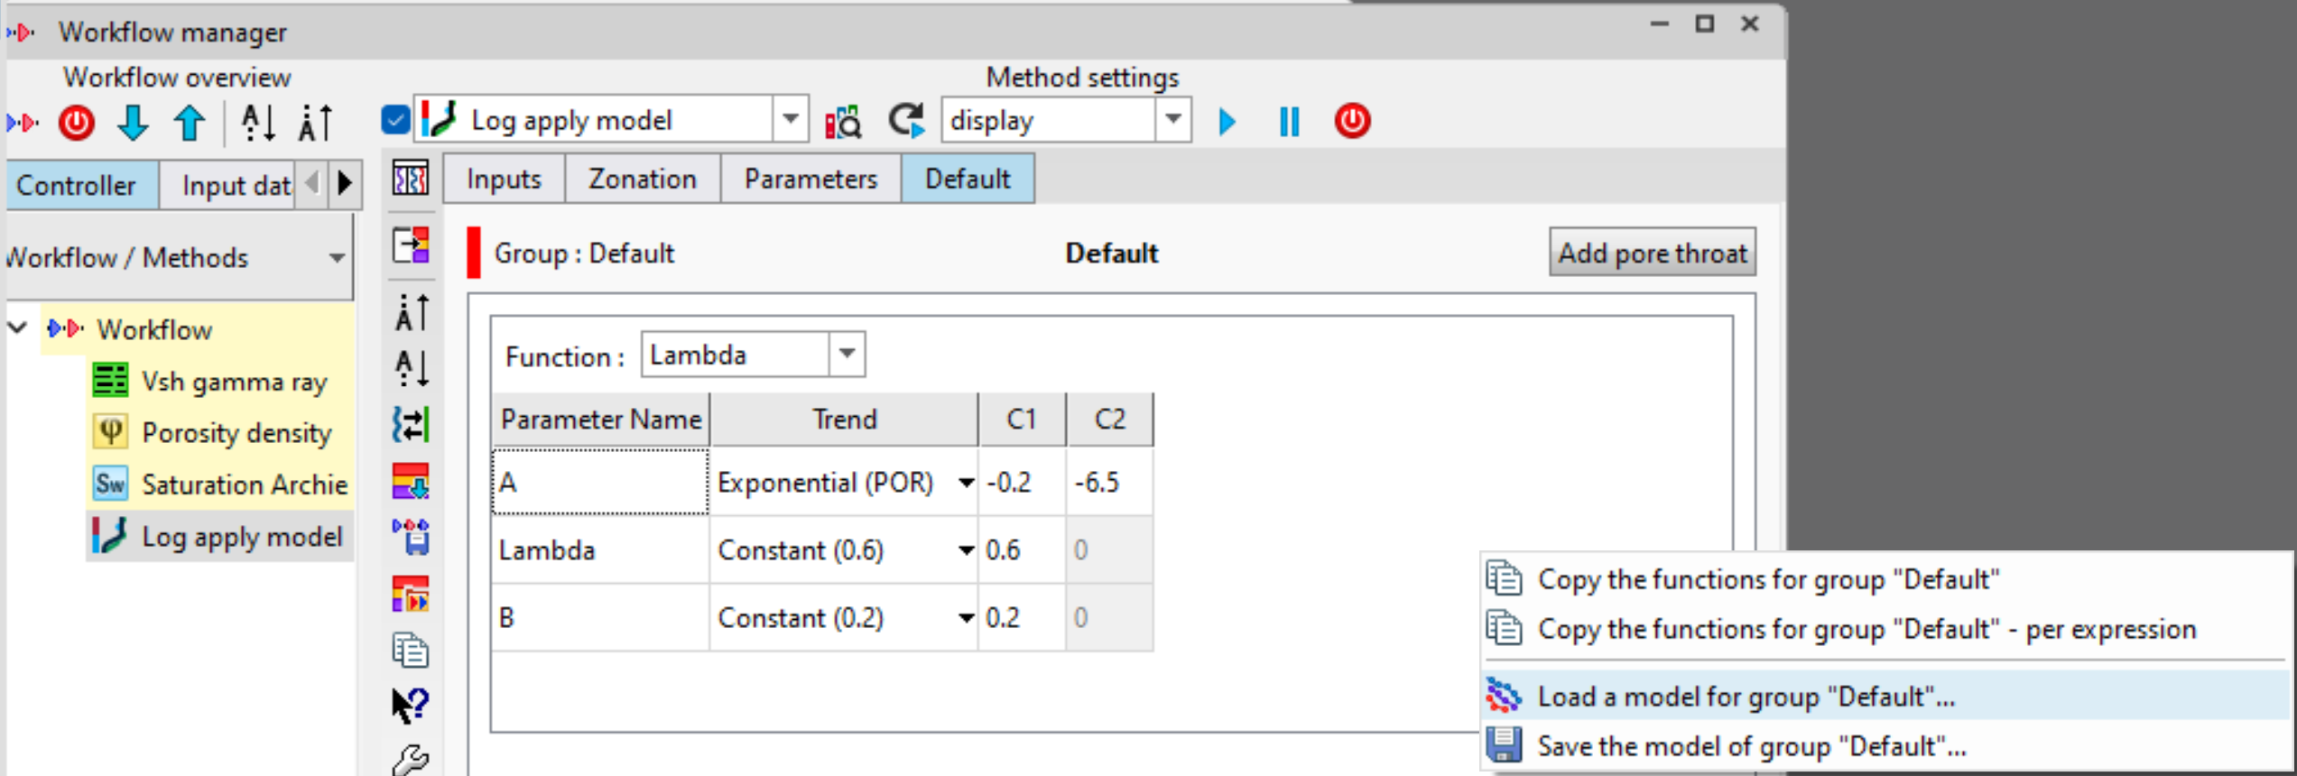
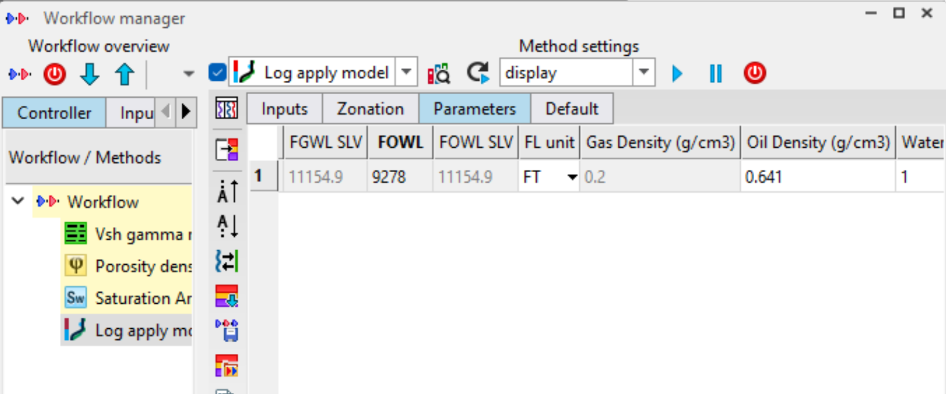
SATURATION HEIGHT MODEL
SELECT THE INPUTS AND CLICK ON CREATE
ON THE RESERVOIR TAB, CLICK ON LOG APPLY MODEL
INSERT THE RESERVOIR ZONE IN THIS CASE
ALTERNATIVELY, IF SHM IS AVAILABLE FOR AN ANALOG WELL, RIGHT CLICK AND LOAD THE MODEL AND ADJUST THE CONSTANTS UNTIL IT MATCHES OUR WELL
ON THE DEFAULT TAB, FUNCTIONS AND CONSTANTS CAN BE ADJUSTED UNTIL IT MATCHES WITH OUR WELL
INPUT PARAMETERS, OIL WATER CONTACT CAN BE READ FROM THE LOGS

Slide 10
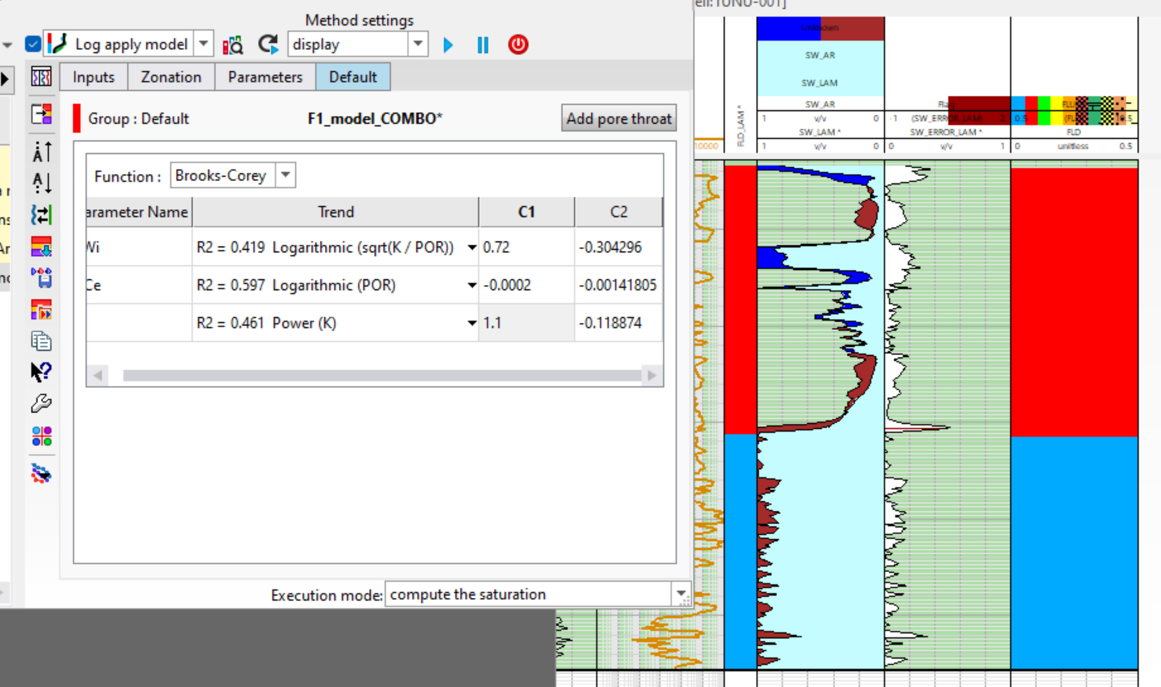
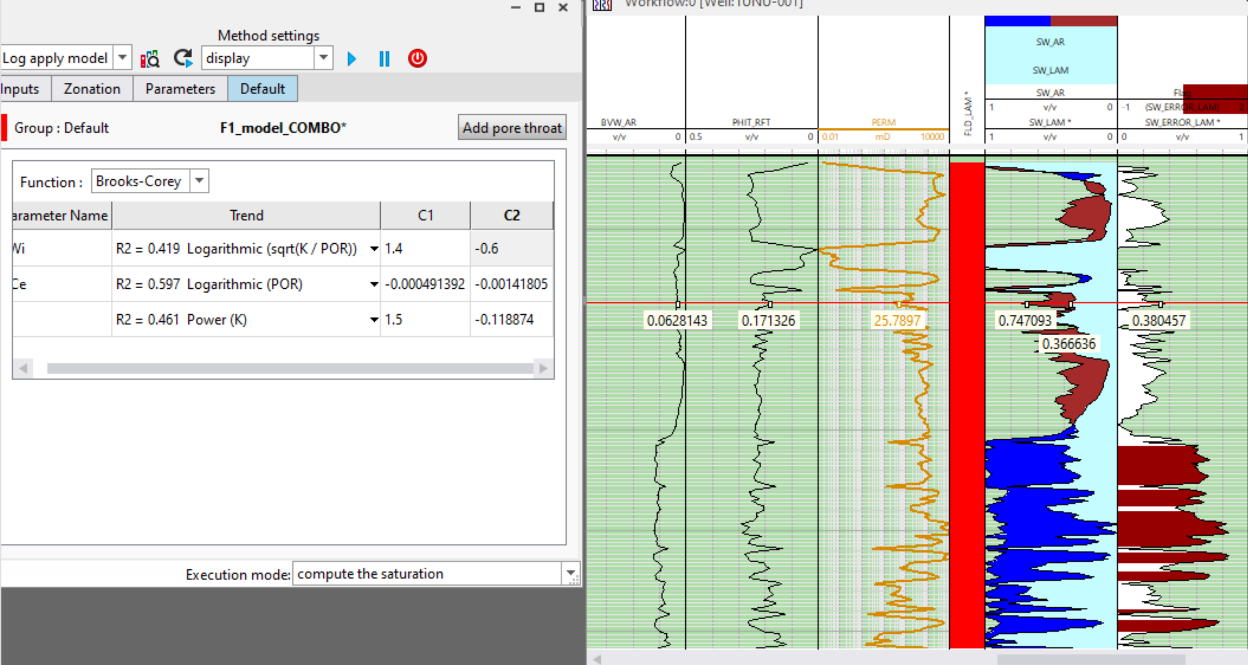
SATURATION HEIGHT MODEL (2)
ADJUST CONSTANTS AND KEEP RUNNING THE EVALUATION UNTIL THE Sw AND THE SHM MACTH AS CLOSE AS POSSIBLE
CLOSE ENOUGH MATCH. RIGHT CLICK AND SAVE THE MODIFIED VARIABLES
ERROR LOG SHOULD BE AS LOW AS POSSIBLE. USE THIS TO QC RESULT
NOTE: SHM SHOULD BE EVALUATED USING PRE-PRODUCTION WELLS AND CAN THEN BE APPLIED TO OTHER WELL TO SEE ORIGINAL FLUID DISTRIBUTION.

Slide 11
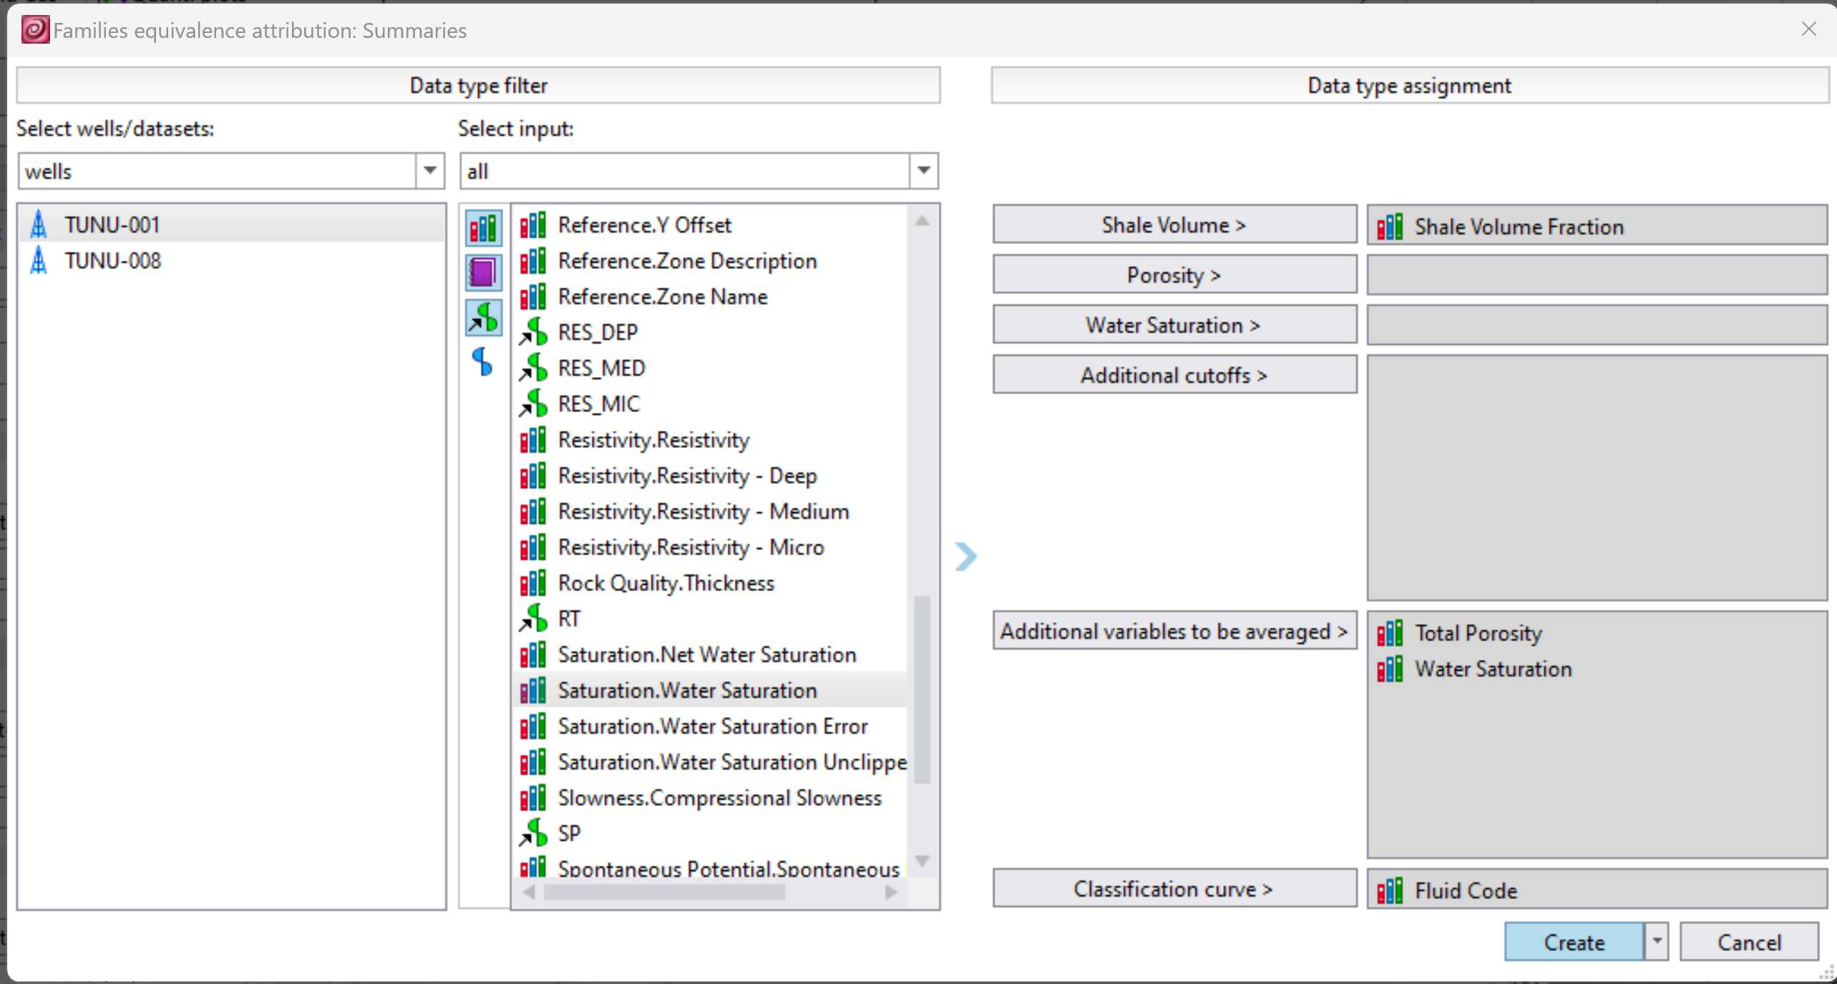
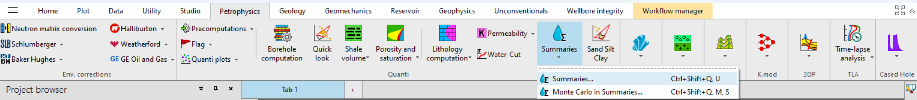
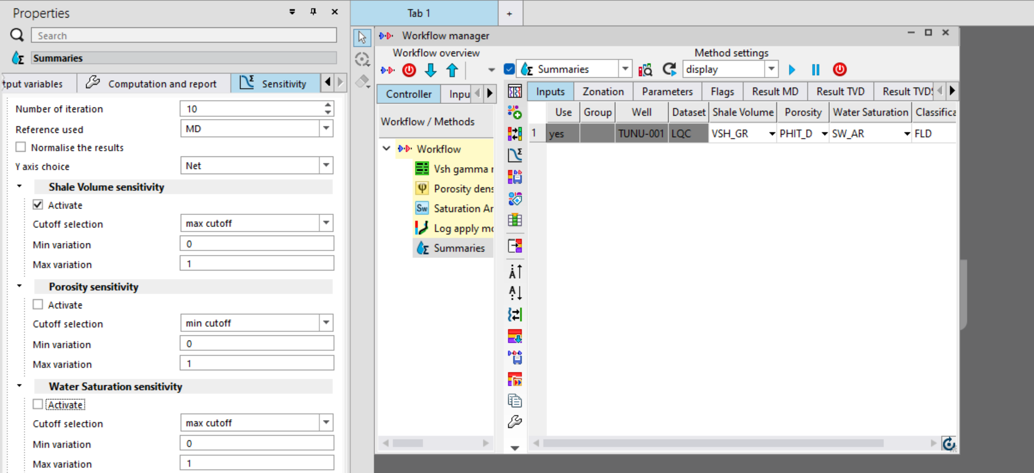
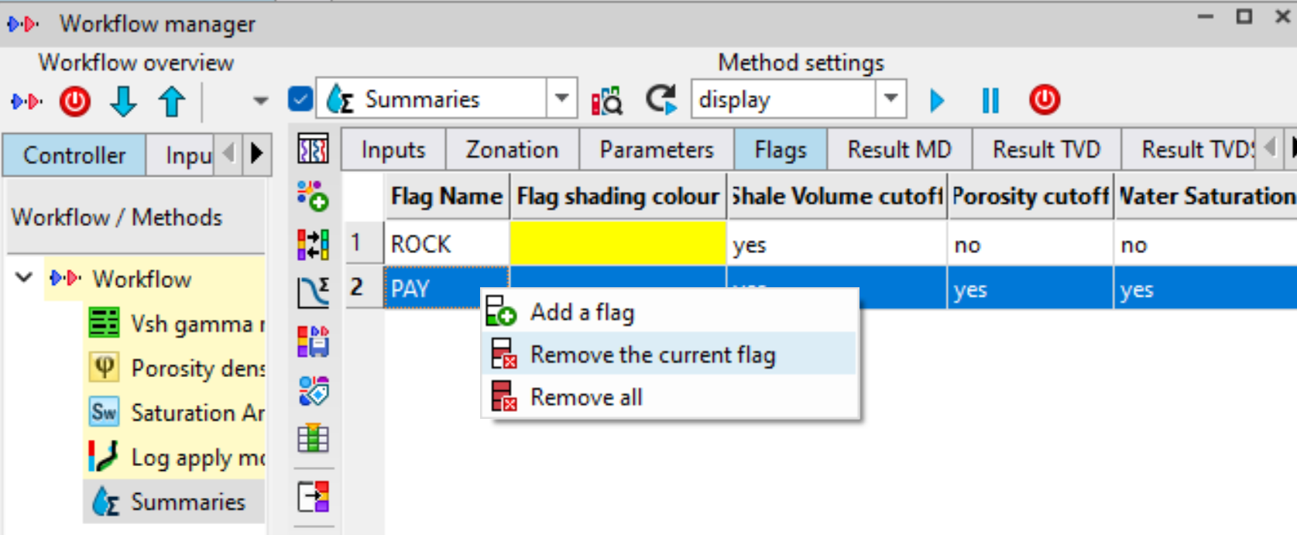
SUMMARIES
ON THE PETROPHYSICS TAB, SELECT SUMMARIES
SELECT THE INPUTS AND CLICK ON CREATE
SELECT VARIABLE LOG INPUTS
SELECT AND REMOVE OTHER FLAGS, ONLY KEEP ONE FLAG
SELECT THE INPUT AND ON THE PROPERTIES WINDOW, SELECT SENSITIVITY AND CHECK ONLY SHALE VOLUME SENSITIVITY
CLICK ON THIS ICON TO RUN SHALE VOLUME SENSITIVITY

Slide 12
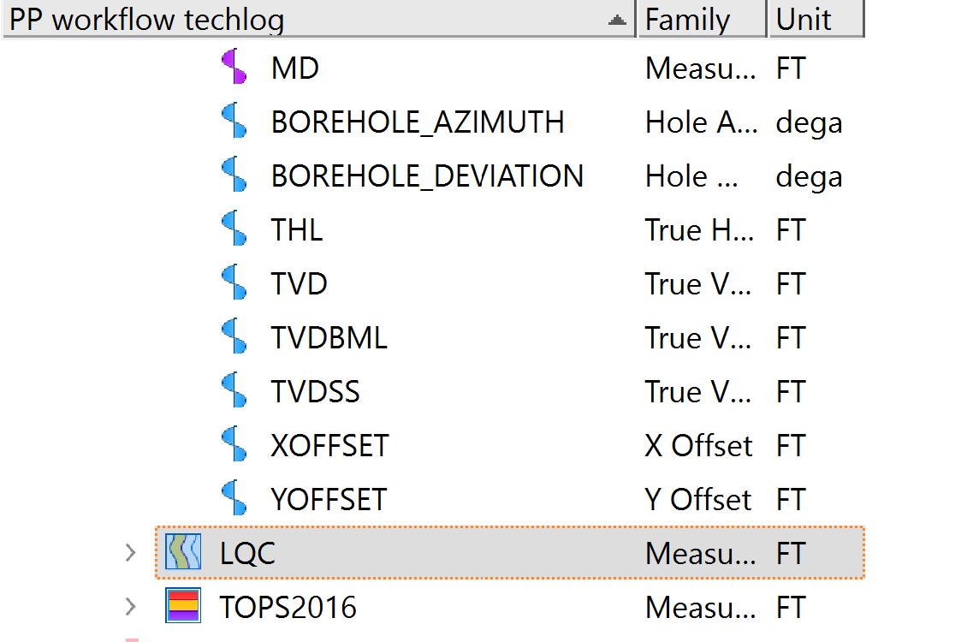
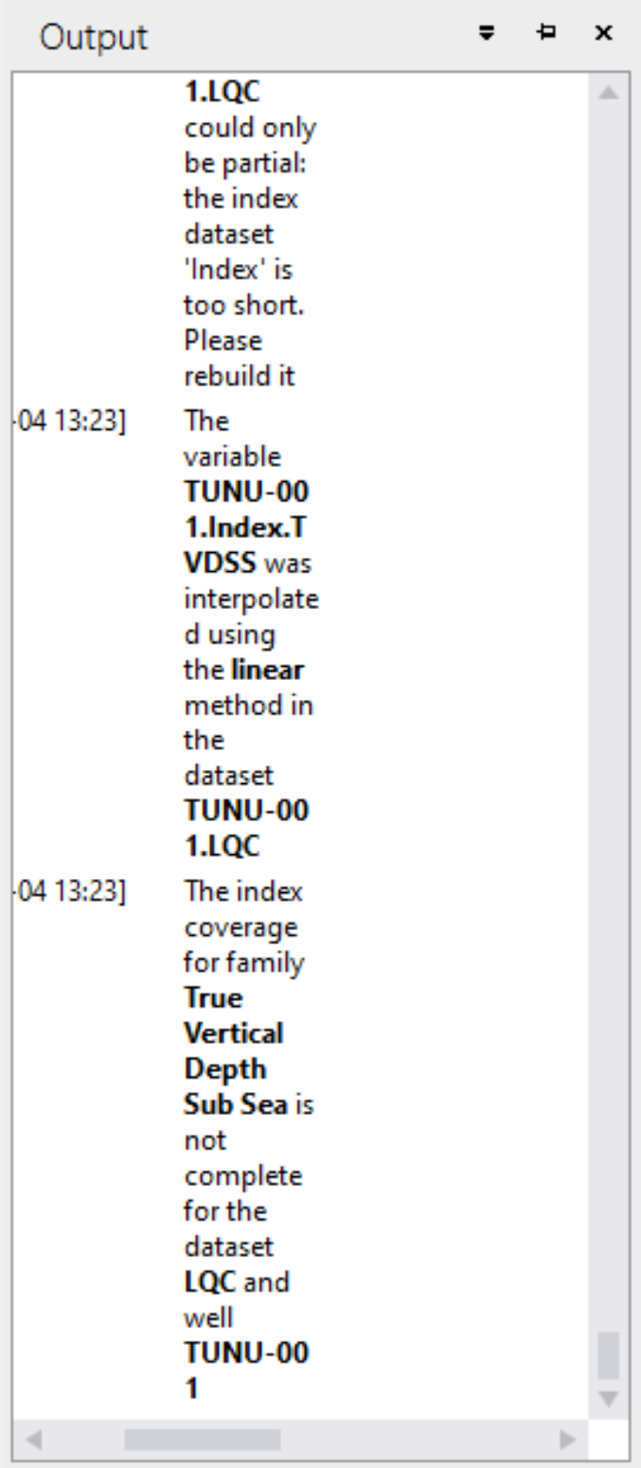
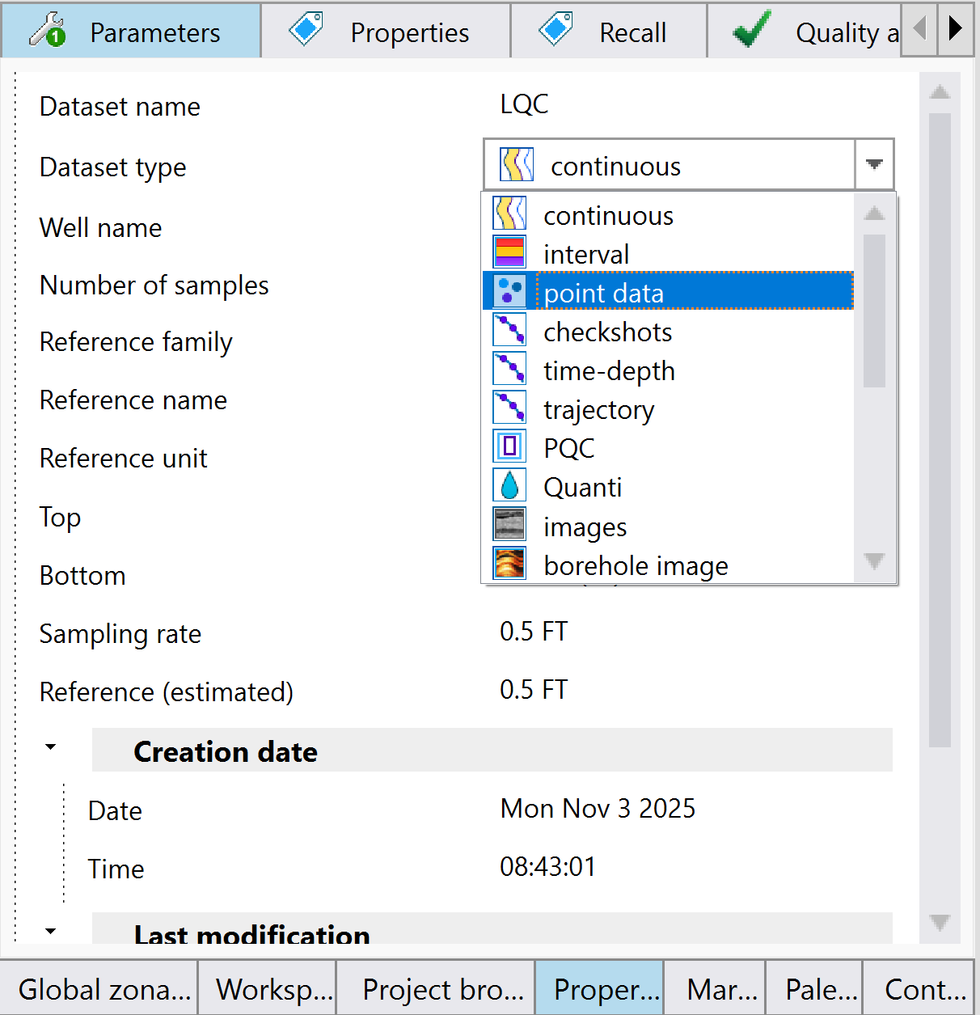
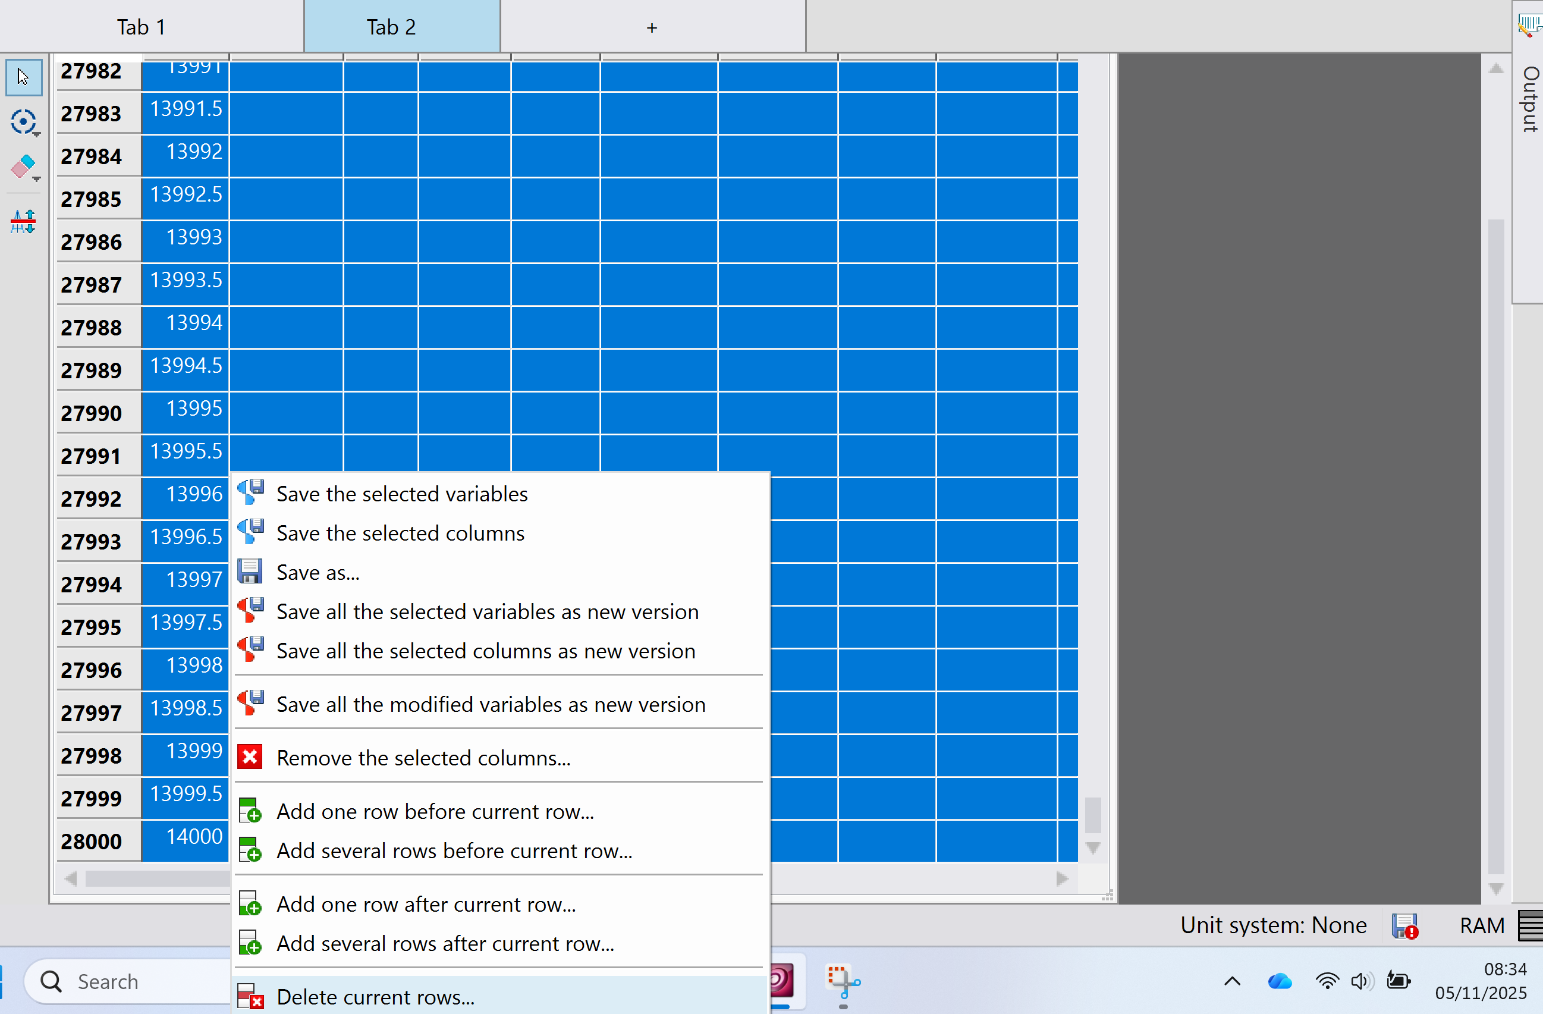
SUMMARIES (ERROR-SKIP IF NO ERROR)
PUT THE LQC AND INDEX ON DATA EDITOR, CHECK THE DEPTH DIFFERENCE AND MAKE SURE THEY HAVE THE SAME DEPTH OR LQC IS LESS THAN INDEX DEPTH. SELECT ALLL ENTRIES OF DEPTHS GREATER THAN INDEX ON THE LQC DATA EDITOR, RIGHT CLICK AND SELECT DELETE CURRENT ROWS. SAVE ALL MODIFIED VARIABLES
IF NOTHING HAPPENS, CHECK OUTPUT WINDOW IF THIS ERROR SHOWS UP
TO FIX THIS, SELECT LQC AND INDEX ON THE PROJECT BROWSER, GO TO PROPERTIES AND CHANGE THE DATASET TYPE TO POINT DATA
CHANGE LQC AND INDEX BACK TO CONTUOUS

Slide 13
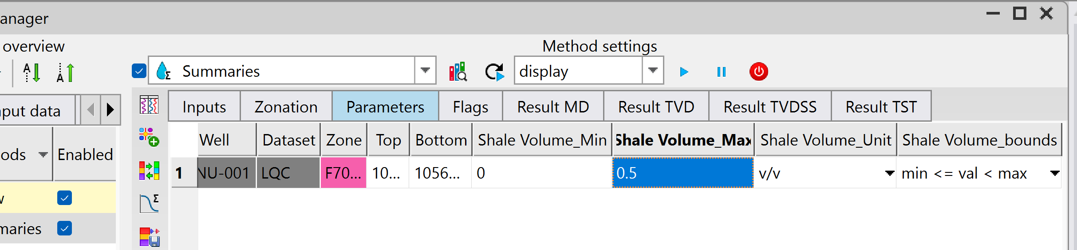
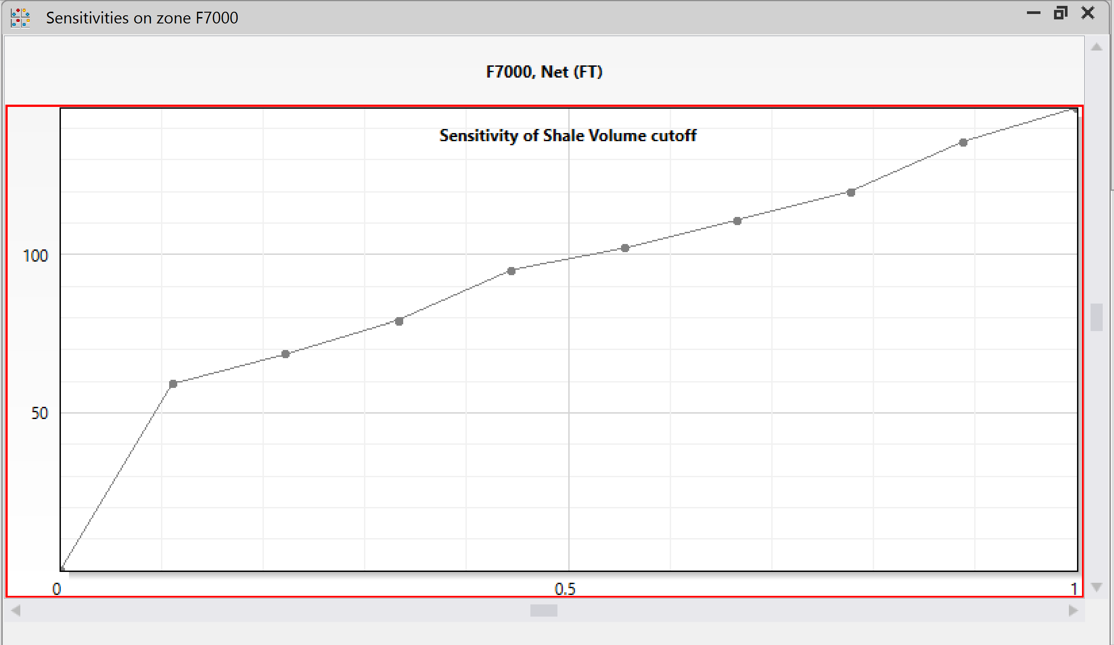
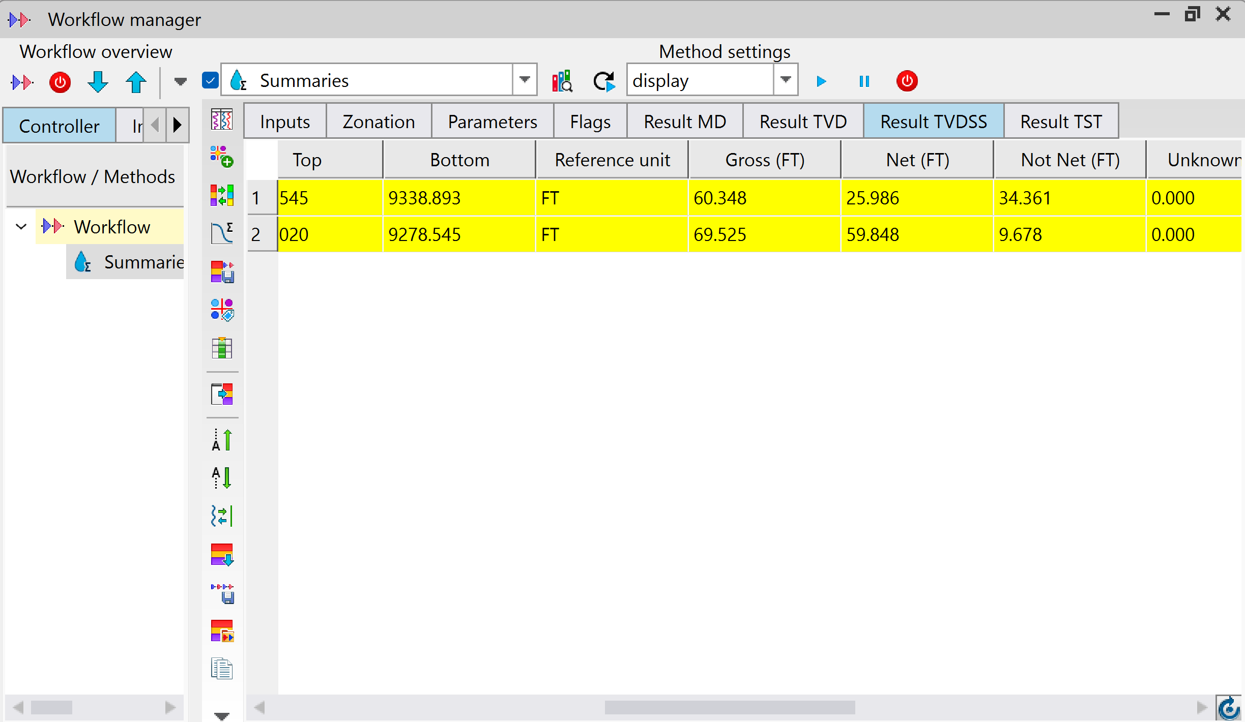
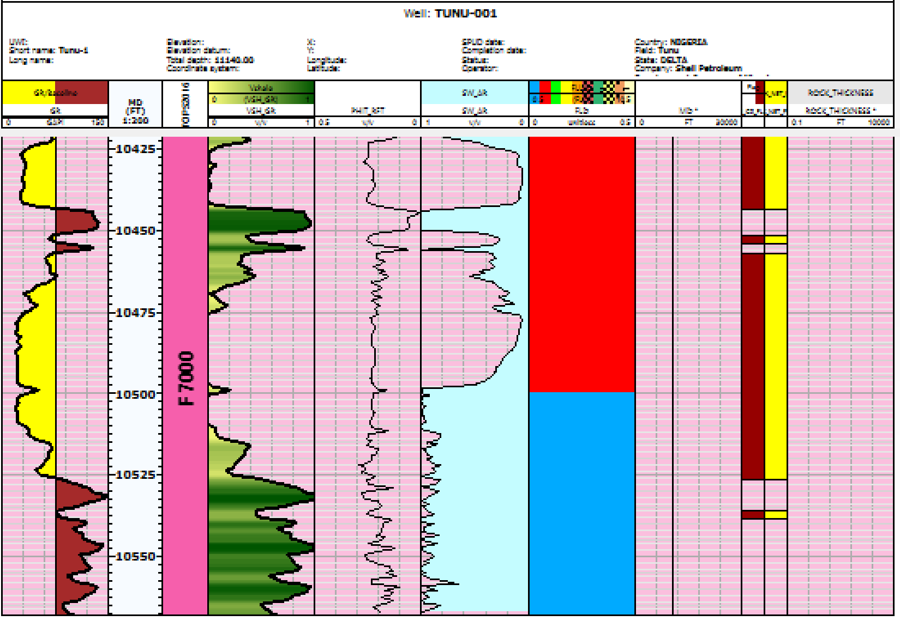
SUMMARIES (2)
FROM THE SHALE SENSITIVITY PLOT, SELECT A VALUE ON THE X-AXIS THAT DOES NOT PRODUCE SIGNIFICANT CHANGE ON THE Y-AXIS. INPUT THAT VALUE IN THE PARAMETERS
CLICK ON RESULTS TO VIEW THE AVERAGES
RUN THE SUMMARIES EVALUATION AND WE SHOULD HAVE OUR NET FLAG (N/G). SAVE AL MODIFIED VARIABLES
CLICK ON THIS ICON TO COPY THE RESULTS TABLE

Slide 14
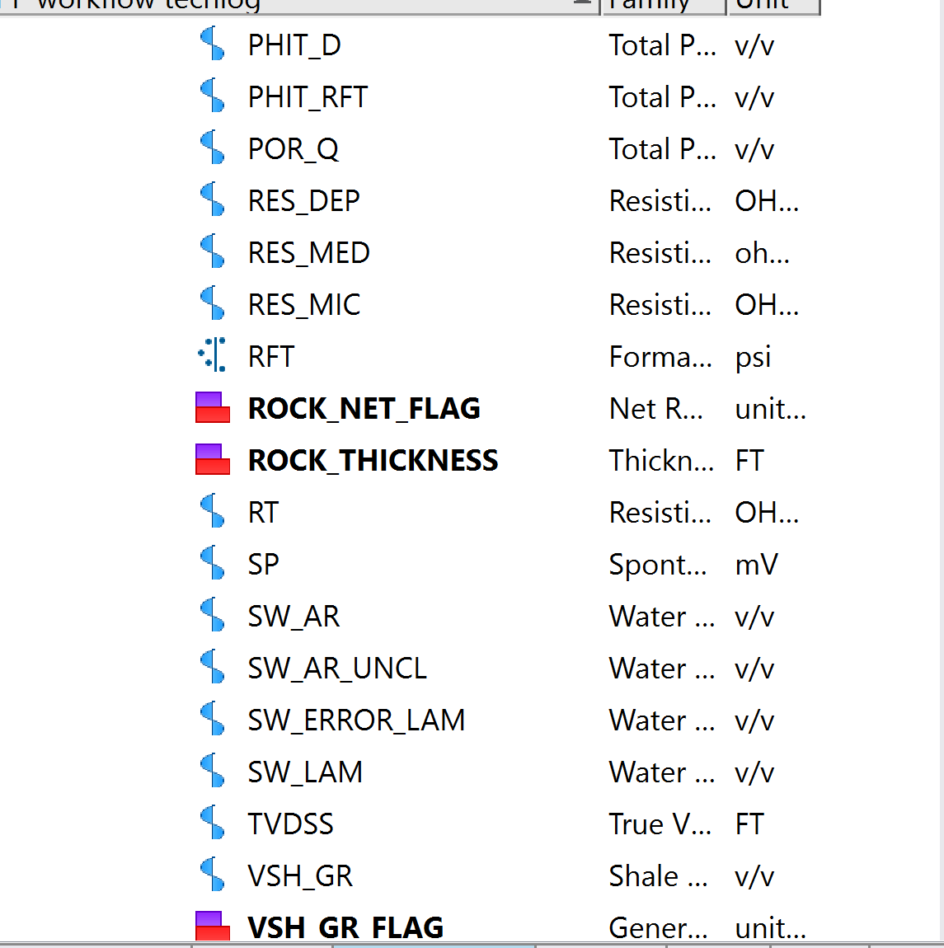
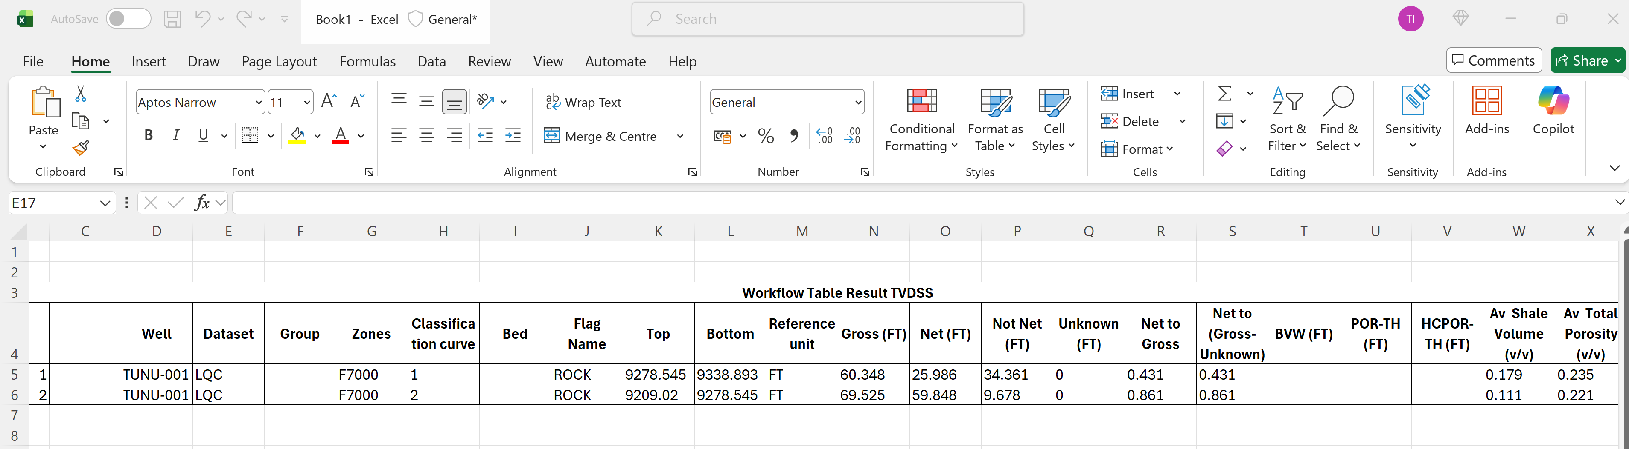
SUMMARIES (3)
ALL PETROPHYSICAL PROPERTIES LOGS HAVE BEEN SAVED AND READY FOR EXPORT TO THE PRODUCTION GEOLOGIST AND THE RESERVOIR ENGINEER
PASTE THE RESULT TABLE IN EXCEL AND ARRANGE IT IN YOUR DESIRED FORMAT FOR PRESENTATION
LOW AND HIGH CASE POROSITY LOGS CAN BE CREATED BY SUBTRACTING AND ADDING 0.03 (3% ASSUMED) TO THE POROSITY LOG AND THEIR CORRESPONDING PERMEABILITY LOGS CAN BE CREATED USING THE SAME EQUATION USED EARLIER, THIS TIME USING THE LOW AND HIGH CASE POROSITY
A NET POROSITY AND NET PERMEABILITY LOG CAN ALSO BE CREATED BY MULTIPLYING POROSITY AND PERMEABILITY BY THE NET FLAG IN DATA EDITOR

Slide 15
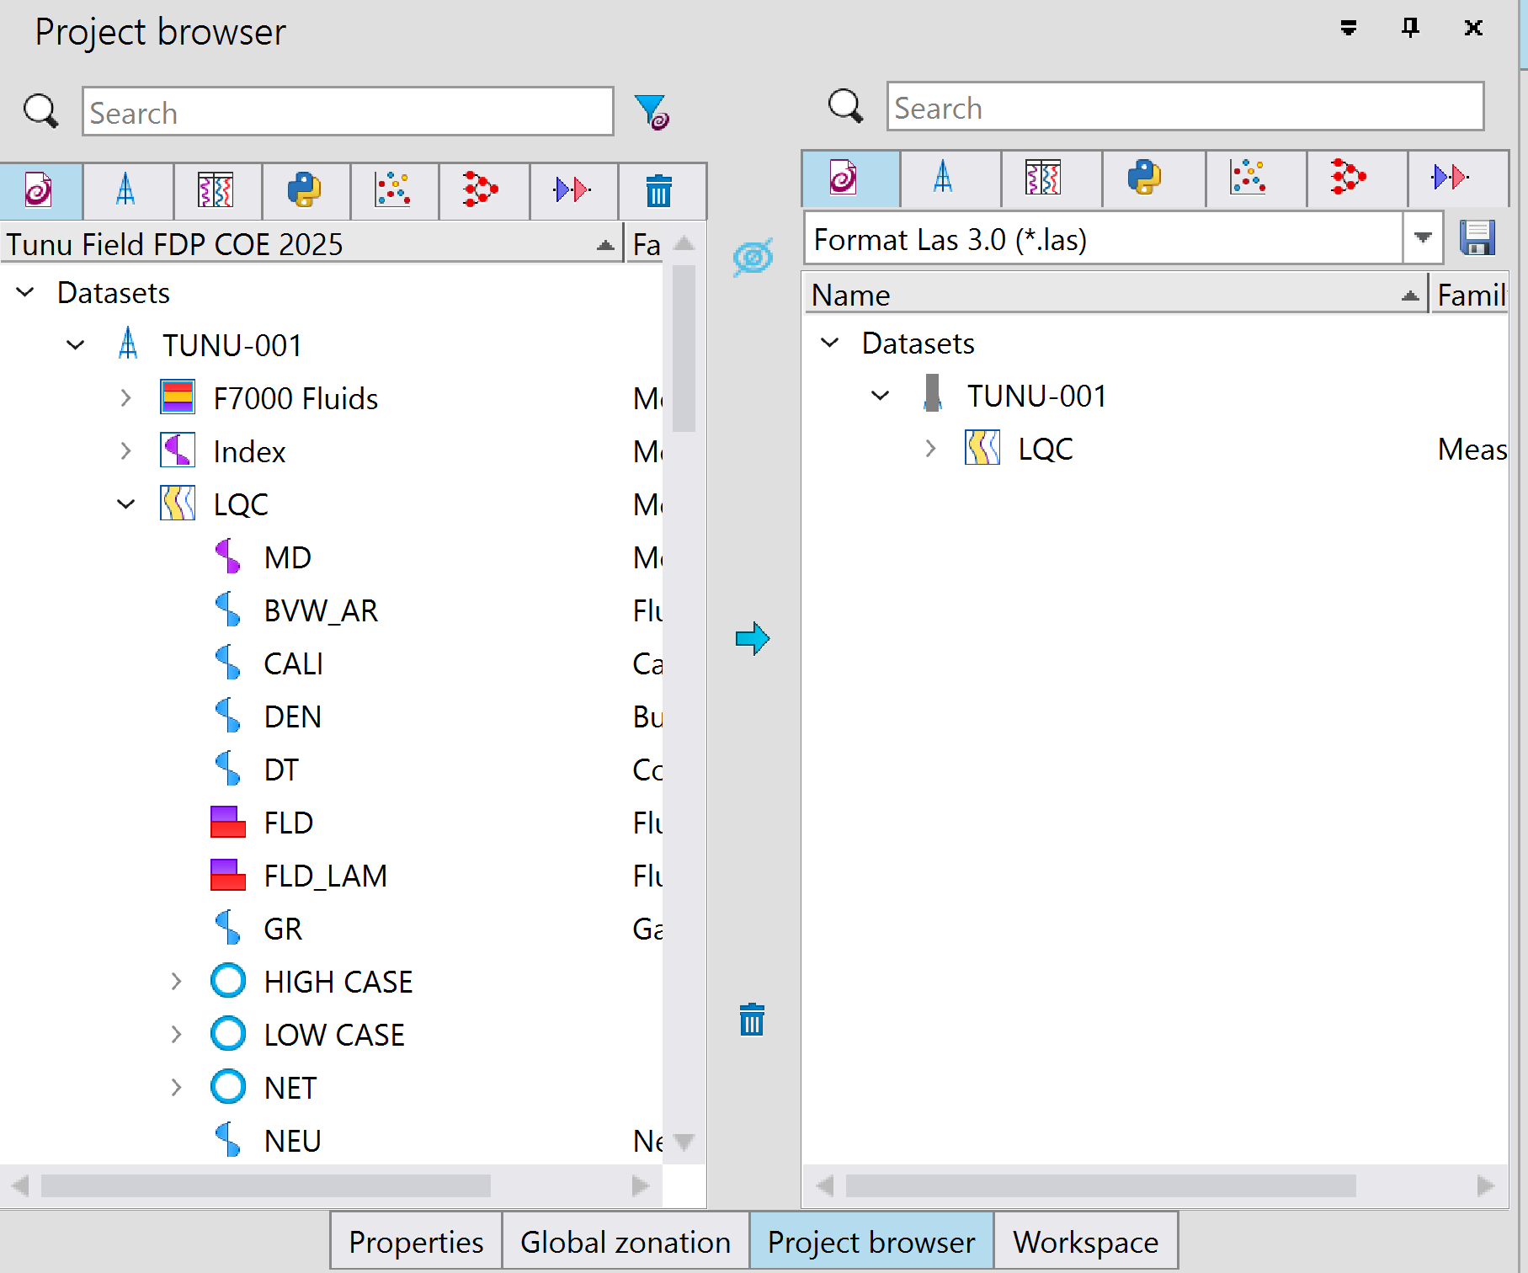
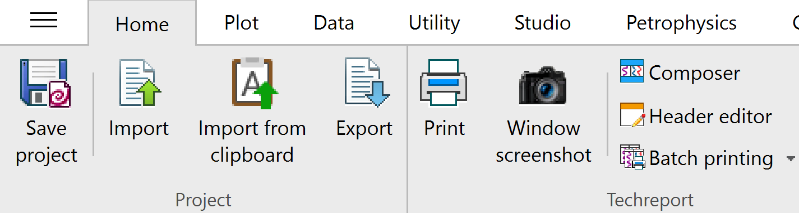
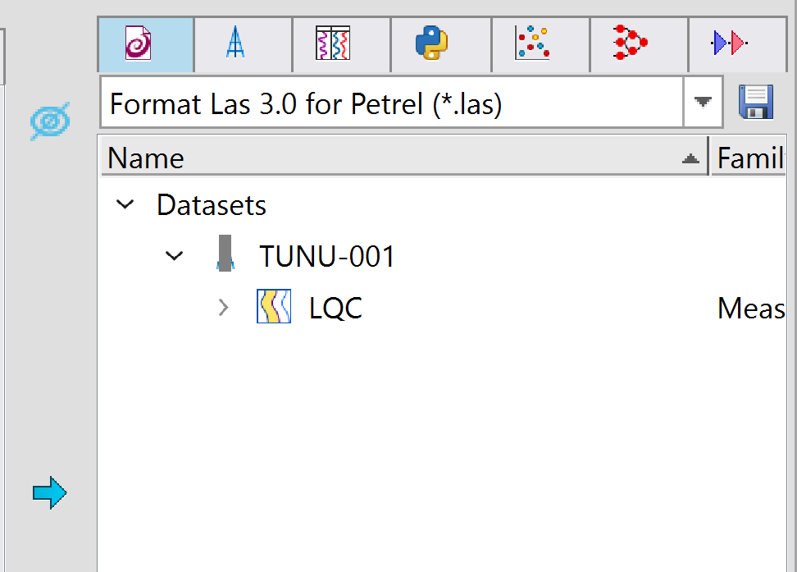
EXPORT RESULTS
SELECT THE LOGS YOU WISH TO EXPORT AND CLICK ON THE ARROW TO MOVE THEM TO THE EXPORT WINDOW
ON THE HOME TAB, CLICK ON EXPORT
SELECT THE DESIRED FORMAT AND CLICK ON SAVE TO SELECT A FOLDER TO SAVE ON PC
NOW YOUR OUTPUTS ARE READY TO BE RECEIVED
NOTE: SATURATION HEIGHT MODEL GOES TO THE RESERVOIR ENGINEER WHILE THE LOGS GO TO THE PRODUCTION GEOLOGIST

